Slide 1
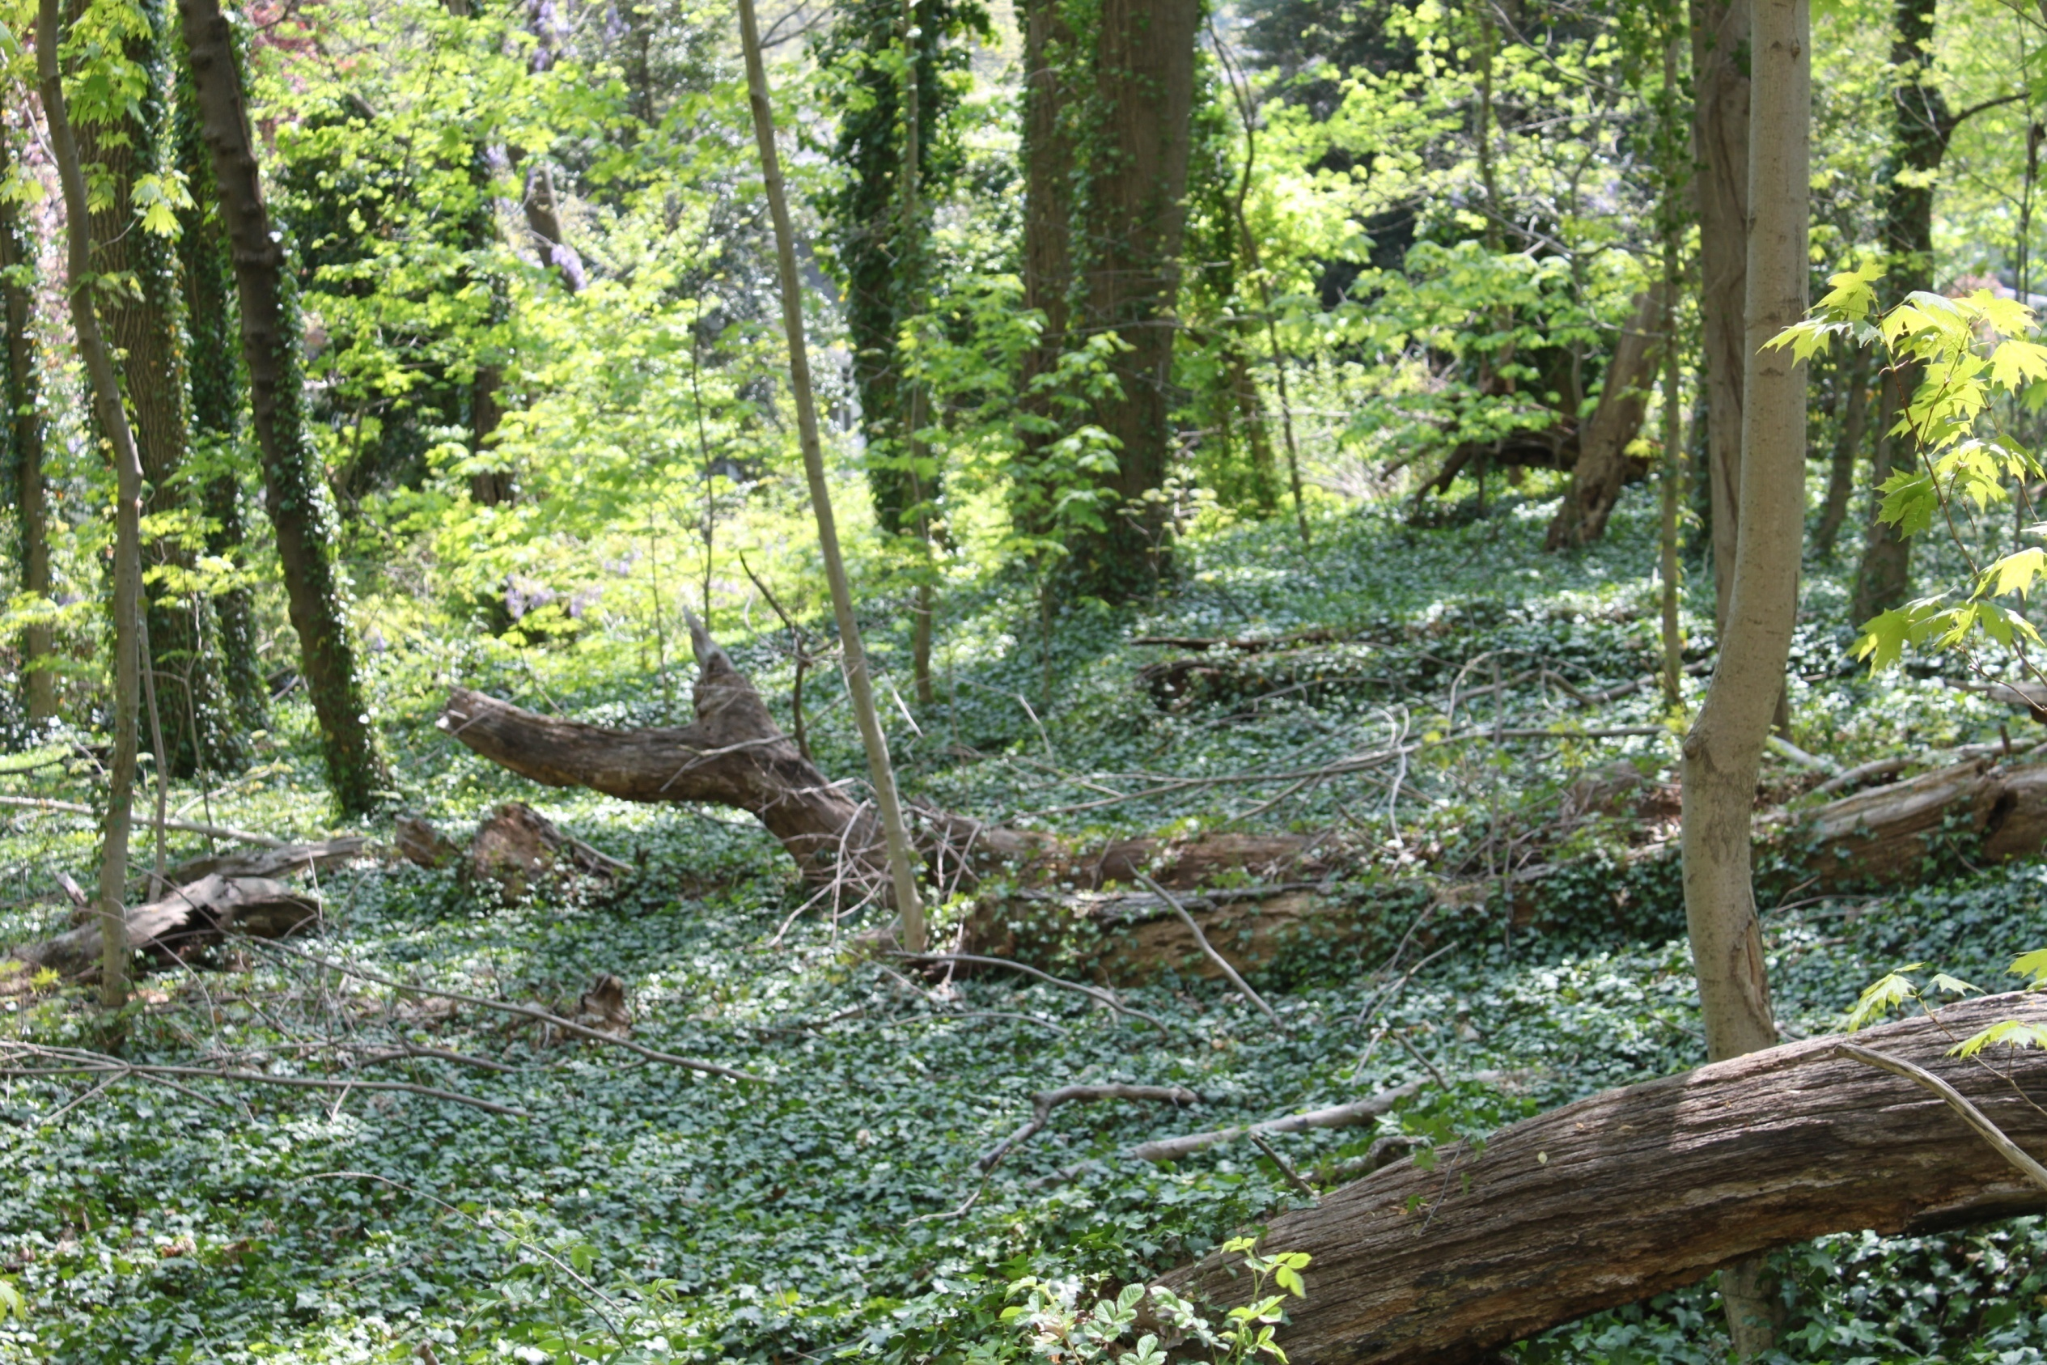
Invasive Species – Map Them and Zap Them!
Notes:
We appreciate your interest in learning about the invasive species that are threatening New Jersey’s natural systems. Our goal with this program is to share some insights and tools that we hope will make it easier for you to identify and manage invasive species in your community.

Slide 2
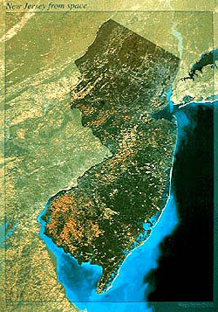
NEW JERSEY
INVASIVE SPECIES
STRIKE TEAM
Our Mission: Prevent the spread of emerging invasive species across New Jersey
New Jersey’s first Cooperative Invasive Species Management Area (CISMA)
Formed in 2008 as Central Jersey Invasive Species Strike Team
Expanded statewide in 2011 & incorporated as 501(c)(3) organization
www.njisst.org
Notes:
To begin, we’d like to give you a little background on our Strike Team and talk a bit about invasive species in general. Our Strike Team came to life in 2008 as a project in central New Jersey. Staff members from two conservation organizations, the Friends of Hopewell Valley Open Space and the Upper Raritan Watershed Association, began working together that year to manage invasive plants on properties owned and managed by the two organizations. Word quickly spread about the work they were doing within New Jersey’s conservation community, and everyone encouraged them to take their efforts state-wide. We all recognized the fact that invasive species don’t recognize property or geographical boundaries and we knew that to truly be successful we have to manage invasive species on a regional level. We formed the state-wide non-profit organization known as the New Jersey Invasive Species Strike Team in 2011 and we’ve been going strong ever since!
2

Slide 3
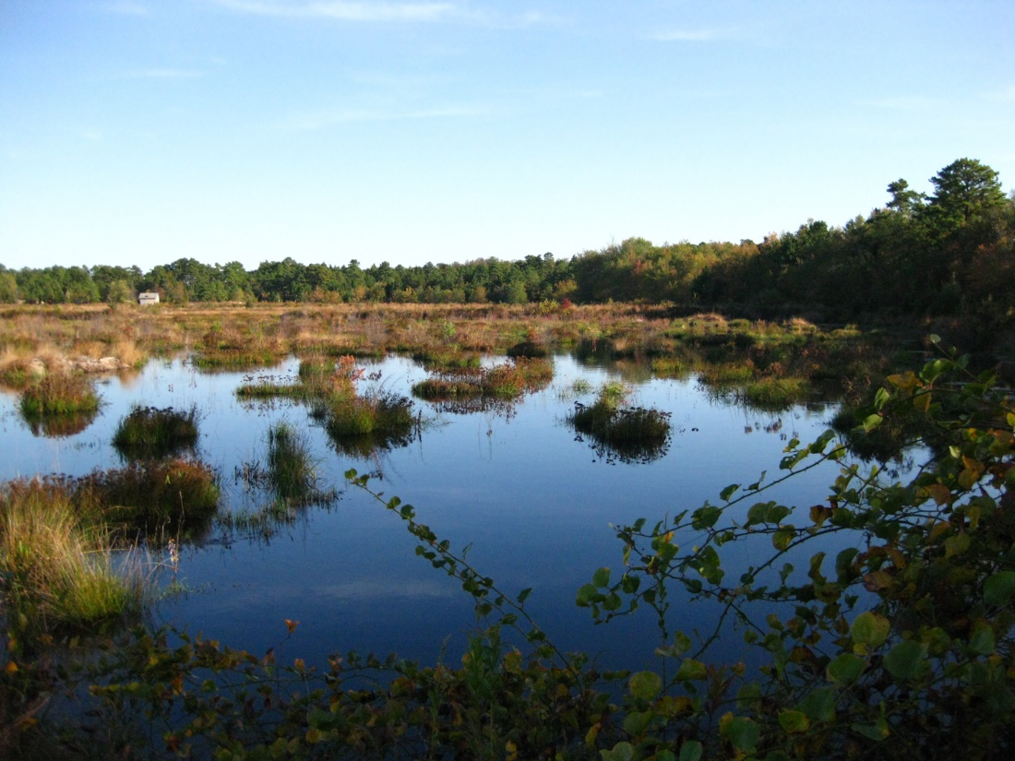
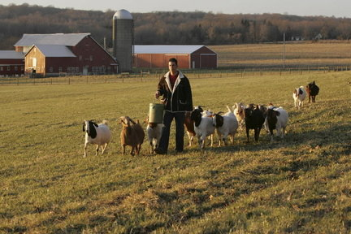
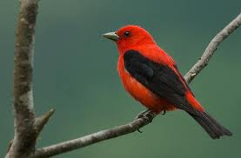
What are we protecting?
Notes:
As you would suspect, our Strike Team is working to protect the natural systems and natural resources of the Garden State. We are also working to protect the agricultural heritage and economy of New Jersey, both of which can be tremendously impacted by invasive species. With such a comprehensive approach to our work, we can gain access to important audiences that we wouldn’t reach if we stayed within the stereotypical environmental community – it’s very important for us to engage farmers, nurserymen, and others within the business community as well as the elected and appointed officials who set policies for our state.
3

Slide 4
Invasive Species
Non-native
Negatively impact other species
Reduce biodiversity
Interrupt the natural functions of an ecosystem
Invasive Species
can be:
Plants
Birds
Insects
Pathogens
Amphibians
Crustaceans
Mammals
Mollusk
Reptile
Fish
Notes:
It’s important for all of us to speak the same language when we discuss invasive species.
We define an invasive species as one that is:
not native (or alien) to the ecosystem under consideration and
whose introduction causes or is likely to cause economic or environmental harm or harm to human health.
Broadly speaking, invasives can be divided into two categories: emerging and widespread. As their names suggest, emerging invasive species are those that are relatively new to an area and have not yet gained enough of a foothold (or roothold) to establish large populations across the landscape, whereas widespread invasive species have done just that.
The tens rule is a generalization of how many exotic species are likely to become invasive
Of all exotics brought into an area about 10% will establish in wild
Of all those established in wild about 10% will establish self- reproducing pops
Of all self-reproducing pops, 10% will become invasive
Thus about 1/1000 species introduced will become invasive, as a general rule of thumb

Slide 5
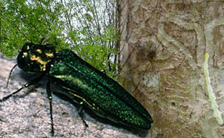
Characteristics
Tolerate a variety of habitat conditions
Grow and reproduce rapidly
Compete aggressively for resources (food, water, nesting sites)
Lack natural enemies or pests in the new ecosystem
Impacts
Prey on native species
Example… Northern snakehead
Wreak havoc when they become entangled in machinery
Example… Kudzu
Inhibit the growth of crops & native forest species
Example… Garlic mustard
Change soil chemistry & reduce its stability & productivity
Example… Autumn olive
Form dense mats on ponds & clog slow‐moving irrigation
channels
Example… Water chestnut
Destroy plants from the roots up
Example… Phytophthora root rot
Notes:
The impacts of invasive species are tremendous. In fact, they pose the second-greatest threat to biodiversity worldwide – only the destruction of habitats poses a greater risk to biodiversity than invasive species do.
Here in New Jersey, we see examples every day – a fish that preys on native fish, plants that change soil chemistry, plants that clog irrigation channels and muddle up farm equipment, insects that have the potential to wipe out huge tracts of native forests…

Slide 6
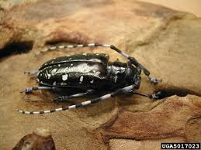
How do species get in the “wrong” place?
Unintentional Introduction
Cultivation & Landscaping
garlic mustard, buckthorn
Nursery Stock
wooley adelgid, chestnut blight
Ship Ballast
zebra mussel, round goby
Boats, Planes, Trucks & Trains
brown tree snake, Eurasian water milfoil
Packing & Shipping Materials
Japanese stiltgrass, Asian long-horned beetle

Slide 7
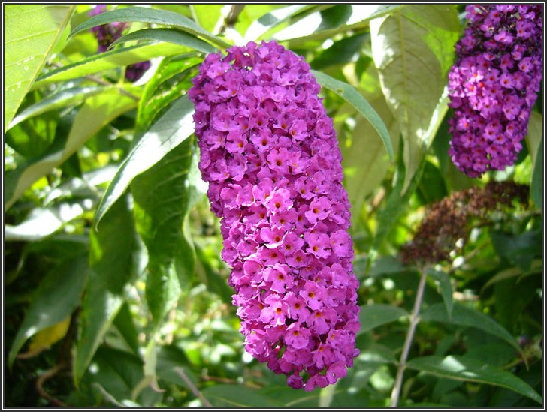
How do species get in the “wrong” place?
Deliberate Introduction
Sport Fishing
snakehead, rainbow trout
Pet Trade
hydrilla, pythons
Biocontrol
Grass carp
Erosion Control
kudzu
Gardening & Landscaping
purple loosestrife, butterfly bush

Slide 8
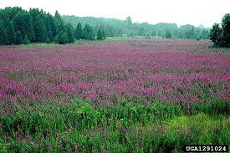
How do species get in the “wrong” place? The Climate Change Connection
Since the beginning of the 20th century, the growing season in many areas of the lower 48 states has expanded by about two weeks…
Many nonnative species are changing their flowering schedule in concert with the longer growing season. At Walden Pond, purple loosestrife blooms 24 days earlier than it did a century ago when Thoreau was documenting the changing seasons there.
Notes:
Botanists have learned that several invasive species are, by nature, highly flexible, and respond to unusual environments more quickly than do natives. And now, with the help of climate change, the invasives also reap the benefits that come with early blooming — such as shading out competitors and capturing a larger share of nutrients, water or pollinators.

Slide 9
How Climate change facilitates the spread of invasive species
Increasing frequency of extreme weather events
Ability to alter critical components of natural systems such as
temperature
precipitation
atmospheric composition
land cover
When heavy winds topple trees in
forests, invasive plants often
outcompete natives for the
sunlight streaming in through
newly-opened gaps in the canopy.
When rivers overflow their
banks, invasive plants &
animals can be transported
to new sites.
Higher average temperatures lengthen
growing seasons, enhance the winter
survival rates of species that would
otherwise suffer die-backs due to freezes,
& expand aquatic habitats for invasive
warm–water species while stressing
populations of native cool-water species.
Notes:
There is considerable evidence suggesting that future climate change will further increase the likelihood of invasion as well as the consequences of those invasions. This is largely because of the potential for complex interactions between
the impact of warming and precipitation changes on population dynamics and species distributions,
increased ecosystem disturbance (e.g. wildfire, hurricanes),
the enhanced competitiveness of some invasive plants due to elevated CO₂, and
increased stress to native species and ecosystems

Slide 10
New Jersey Invasive Species Strike Team: Our Role in Invasive Species Control
Notes:
This diagram illustrates nicely the reason that our Strike Team focuses on emerging invasives, rather than those that are widespread. It shows that detection and prevention make the most sense from monetary, environmental and effectiveness perspectives.
The lower left point represents the arrival of an invasive species into a new area. At first, the number of individuals is quite small, but the species takes advantage of its new surroundings and its population grows. Eventually, the species is discovered, usually by a stakeholder – a scientist, an angler, a hiker, or the like. When it is detected, if action is taken right away, eradication is usually possible – thus the green color of the diagram early on.
If steps are not taken to remove the species from the area, its population will continue to grow. The yellow and orange colors represent this period. Once the population becomes quite large, the public will begin to notice the species, or the effects it is having on the landscape or their health. By this time, the species has infested such a large area that eradication is unlikely and intense efforts are needed to eradicate and prevent further spreading of the invasive.
As more times goes by (the red zone), the population has grown so large and infested such a large area that local control and management are the only options. To understand what we mean by “local control,” think of the brown marmorated stink bug. We’ve all seen these little creatures crawling up the walls in our homes or offices… they seem to be EVERYWHERE during certain weeks of the spring and fall each year. We can hire an exterminator or vacuum them up until we no longer see them inside, but when we look out through our windows we’ll see them crawling on our screens looking for a way in. We can eradicate them from a specific site such as a building, but they are widespread across the landscape and we are not going to eradicate them beyond very localized sites.
We think of widespread invasives as genies out of the bottle… we cannot put them back inside. New invaders, on the other hand, we can nip in the bud!

Slide 11
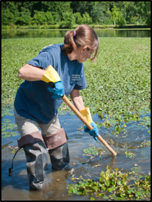
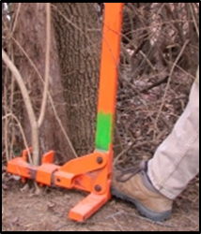
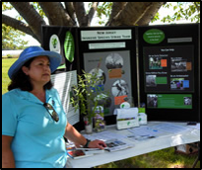
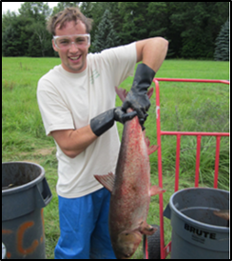
Our Methods
Mapping, Data Analysis & Reporting
Data is mapped, analyzed & shared through our web site
Continually assess distribution & densities of target species
Identify sources & trends of emerging infestations
Provide alerts about species found in the mid‐Atlantic & New England
Outreach
Volunteer Ambassadors attend community events
Programs for property managers, elected officials, garden clubs & civic associations
Invasive plant buy‐backs
Training
Classroom & Field Sessions teach participants to:
Identify targeted species
Properly record data about populations they detect
Safely initiate control/eradication efforts
Searching (Early Detection) & Eradication (Rapid Response)
Public & private land stewards search for emerging invasives
Eradication efforts take into consideration the best management practices in place for each target species
When eradication is not fully possible, we work to contain the populations of each target species
Notes:
The Strike Team exists to do just that. We track where emerging invasive species are being found in New Jersey, as well as the mid-Atlantic and New England regions. We analyze data about species locations, along with control methodologies and their effectiveness. Every spring, we publish a list of invasive species along with fact sheets about each one, which we make available through our web site, a smartphone app and an annual Invasive Species Conference which then kicks off a series of outreach and training programs for audiences all across the state to help people learn to identify, report and safely initiate management efforts. Lastly, we coordinate collaborative efforts amongst landowners and other stakeholders to conduct what is known as ED/RR – Early Detection of and Rapid Response to emerging invaders.

Slide 12
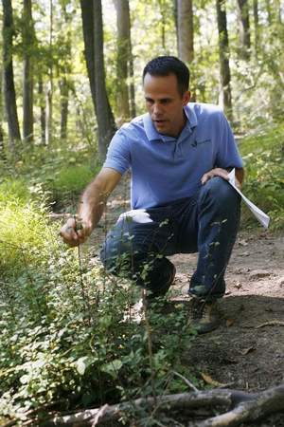
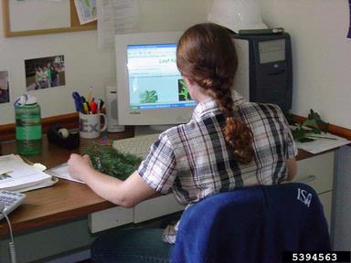
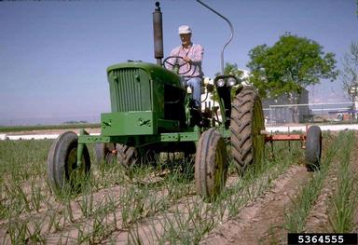
Collaboration is Key
Our Team
Over 200 Partners Representing
all levels of government
non-profit conservation groups
consulting foresters and related businesses
private individuals
Staff
Susan Brookman, Executive Director
Contractors
Mike Van Clef, Science Director
Jim Hansen, GIS Director
Friends of Hopewell Valley Open Space, Technical Specialists
New Jersey Audubon, Project Coordinators
Board of Directors
Jon Wagar, Director of Operations for Duke Farms
Ken Klipstein, Director of Watershed Protection, New Jersey Water Supply Authority
Alda Krinsman, Attorney (Retired)
Keri Benscoter, Resource Management Specialist, Highlands Water Protection and Planning Council
Randy Santoro, Principal Member of Technical Staff, AT&T
Technical Advisory Committee
Thom Almendinger, Duke Farms
Bruce Barbour, Rutgers Cooperative Extension
Kerry Barringer, Board Member – Flora of North America Association
Jeanette Bowers-Altman, NJ Division of Fish & Wildlife
Chris Doyle, Allied Biological
Art Gover, The Pennsylvania State University
Larry Herrighty, NJ Division of Fish & Wildlife
Mark Mayer, NJ Department of Agriculture
Christopher Smith, NJ Division of Fish & Wildlife
Robert Somes, NJ Division of Fish & Wildlife
Notes:
Our shared-services model, which incorporates Strike Team staff, partners, private landowners and volunteers, provides leverage to achieve far more than any one group could accomplish on its own.

Slide 13
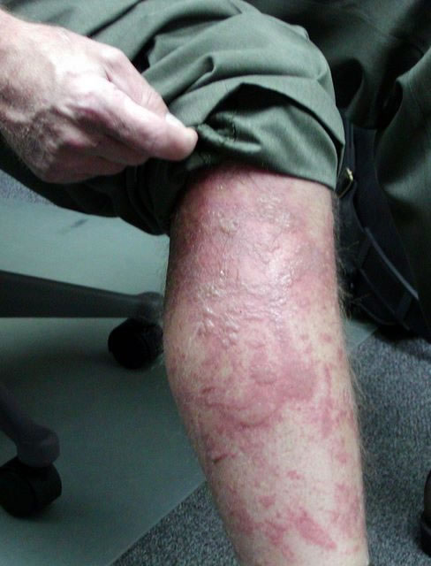
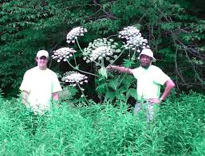
2015 Target Species
134 species
94 plants
40 “other”
1 bird, 11 fish, 15 insects, 2 mammals, 5 mollusks, 5 pathogens and 1 reptile
Giant Hogweed
Notes:
Each year, we update the list of invasive species that have been documented in New Jersey and we issue a “Target List” that includes all of the emerging invasive species.

Slide 14
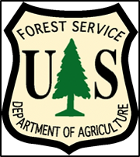
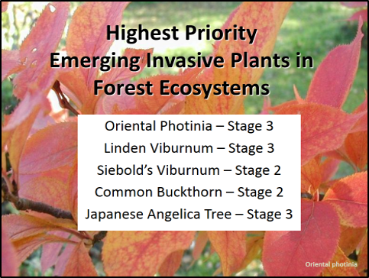
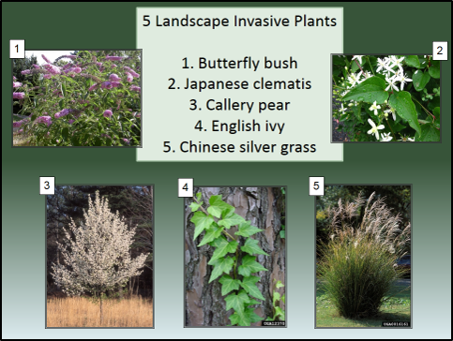
Forest Health Initiative
3-year project to improve forest health in New Jersey
Focus stewardship efforts on high priority forest sites
Gain a more accurate picture of invasive plant distributions & densities
Enhance database & enable partners to learn more about regional invasive species threats & management strategies
Initiate campaign amongst landscapers to promote the voluntary restriction of invasive plants
Notes:
One of the great projects we are engaged in revolves around improving the health of forests by examining the invasive species that are present in them and facilitating work to eradicate or at least control the emerging invasives.
In late 2013 we received a three-year grant from the US Forest Service for this project, which also includes an effort to stem the tide of invasive plants infesting forests from cultivated landscapes. We are working to reduce the demand for invasive plants by educating homeowners… one of the really cool things we encourage conservation organizations and other groups to do is incorporate an invasive plant buy-back into their events. Citizens trade an invasive plant they dig from their garden for a coupon from a local nursery to replace it with a non-invasive plant. We’ll be happy to talk with you more about that idea, so let us know if you are interested in learning more. We are also reaching out to garden centers and landscapers to encourage them to voluntary reduce the supply of invasive plants.

Slide 15
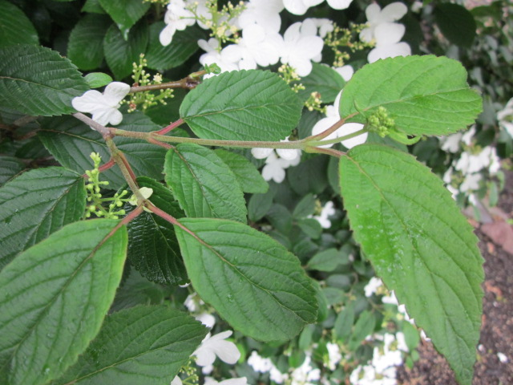
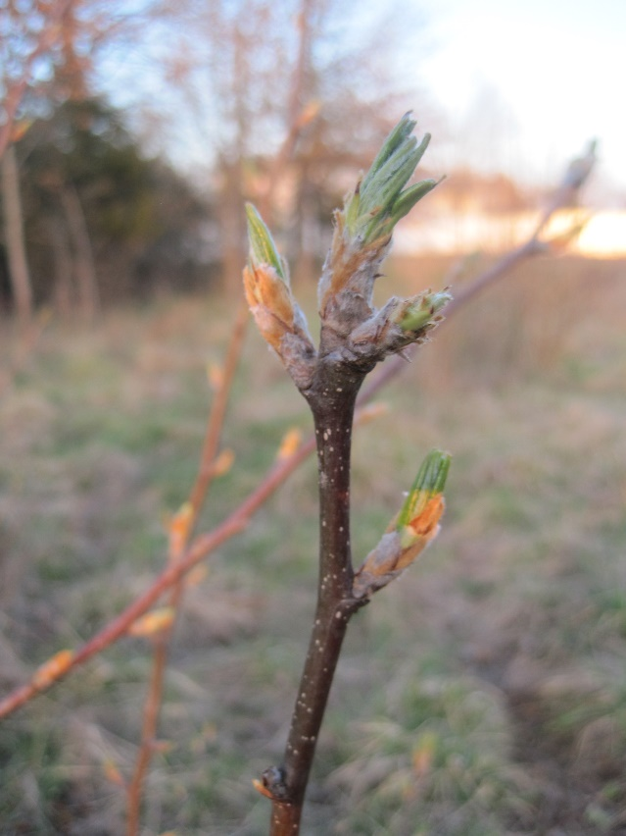
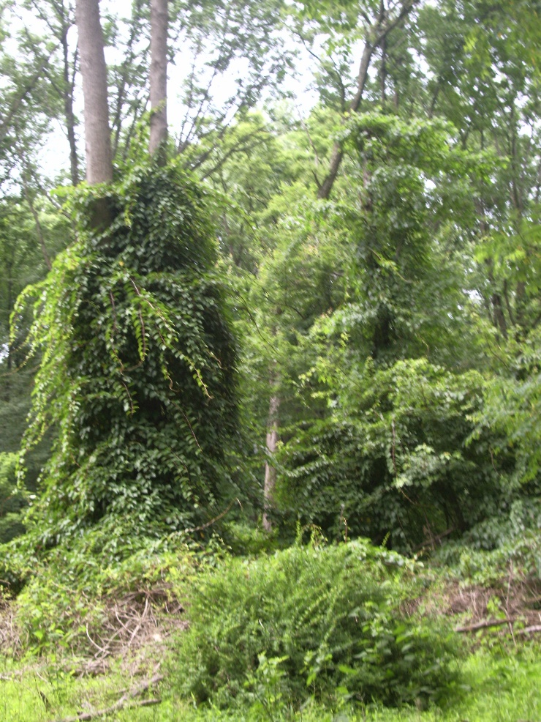
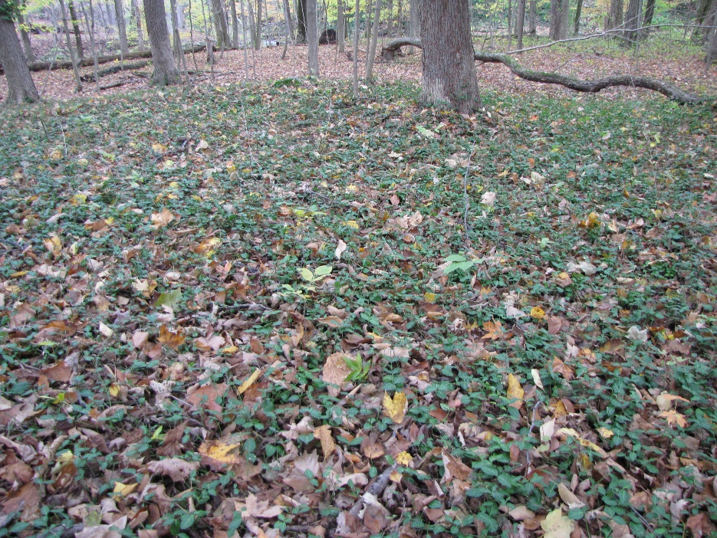
Forest Invaders
doublefile viburnum - 0
autumn olive - ws
hardy kiwi - 0
wintercreeper - 2
Notes:
There are lots of invasive species in our forests…
We assign a code to each species based on the number of populations that have been documented in our state. A Stage O species has been detected here fewer that 10 times – some Stage O’s have not been detected in New Jersey, but they have been reported in nearby states so we need to be on the lookout for them. A Stage 1 species is quite rare – it has been detected in more than 10 locations but fewer than 100. Our stages go from 0 to 3 – once a species has been found in more than 1,000 places, we consider it widespread.
There are some widespread species that landowners always ask us to help them manage at the site level, so first we’ll turn our attention to those.

Slide 16
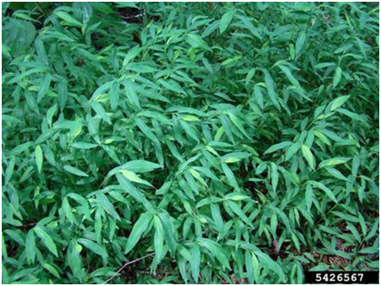
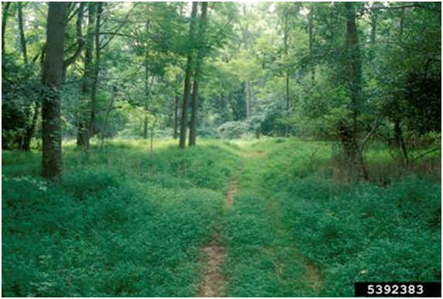
Japanese stiltgrass
Microstegium vimineum
What makes it a successful invader?
It can become established and live in a wide variety of habitats.
Each plant produces hundreds of seeds that can remain viable in the seed bank for upward of five years.
Seed can be transported long distances by water or contaminated hay, seed mix and soil.
Plants also reproduce asexually. They form roots at the nodes, which allows for new vegetative stem growth.
People can spread stilt grass by carrying the seeds on their shoes, equipment and vehicles.
Notes:
First up is Japanese stiltgrass… truly one of New Jersey’s most well-known invasive plants. This slender, branching annual germinates in the spring and grows through the summer months. Its stems are jointed and its root structures above ground are stilt-like, thus its common name…
Family Name: Poaceae - True grass family Native Range: Eurasia NJ Status: Widespread and highly threatening to native plant communities.
General Description
• Slender, branching annual grass • 2-6.5’ tall • Germinates in spring and grows through summer • Stems jointed • Above ground root structures are stilt-like
Leaves
• Alternate arrangement and lance shaped • Pale green with distinctive shiny midrib • 1-3” long • Turn reddish in dry conditions • Slightly hairy
Flowers
• Tiny, borne on slender stalks with 1 to 5 branches • Bloom August through September
Fruit
• Tiny, ~0.1” • Elliptical shape • Range from yellow to yellow-purple • Ripen mid-September through August
Habitat
• Forest, forest edges, meadows, lawns • Prefer moist shaded environments • Can tolerate full sun if moisture is present
Commercially Available
No, but remnants may be contained in soil of purchased landscape plants.
Look-alikes
cutgrass (Leersia virginica)
• Native grass similar in appearance and habitat • Flowers earlier, has sharp leaf edges, and has more open and branched flowers.

Slide 17
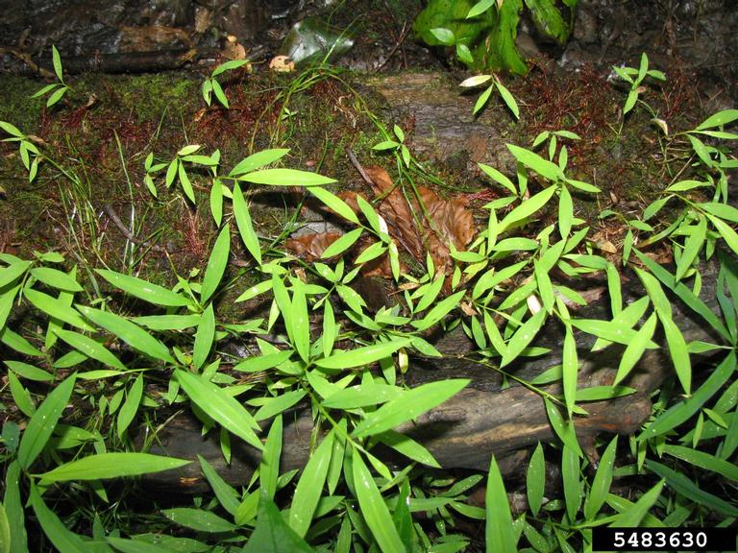
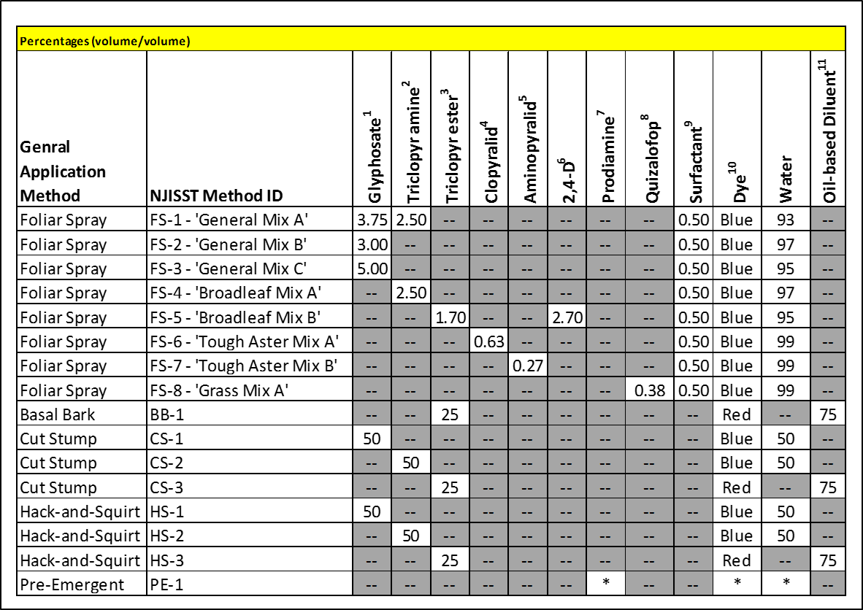
Japanese stiltgrass
Microstegium vimineum
How can I control it?
Seeds remain viable for 3+ years
Chemical: treat before fruit/seed maturation
Foliar Spray – FS 2
Glyphosate 3.00%
Foliar Spray – FS 8
Quizalofop 0.38%
Pre-Emergent Spray – PE1
Prodiamine - See Label Instructions
Mechanical: Pulling can work –
year after year after year after year...
Small Stands: Pull in August or early September when plants are in full bloom, but before seeds are produced.
Larger Stands: Cut the plants in late summer using a mower or weed whacker. Japanese stilt grass cut late in the season will die back and not produce new shoots.
Notes:
Small populations can be controlled and often eliminated by hand pulling or cutting. Hand removal is best done in August or early September when plants are in full bloom, but before seeds are produced. Pulling earlier in the summer disturbs the soil and allows for germination of new plants from the seed bank. For larger stands, a more effective method is to cut the plants in late summer using a mower or weed whacker. Being an annual, Japanese stilt grass cut late in the season will die back and not produce new shoots. Seeds remain viable in the soil for at least three years and germinate readily when the soil is disturbed.
Herbicides can be effective. Our Strike Team offers advice about which chemicals to use, in what concentrations at what time of year for every species on our list of New Jersey’s invasive plants. The table you see here is a cheat sheet for the different mixtures we recommend most often. It is on our web site, along with the species-specific fact sheets and oodles of other resources to help in your efforts to manage each species on your property.
Extensive populations can be controlled by applying a systemic herbicide like glyphosate (e.g., RoundupTM or RodeoTM),as a foliar spray or pre-emergent treatment.

Slide 18
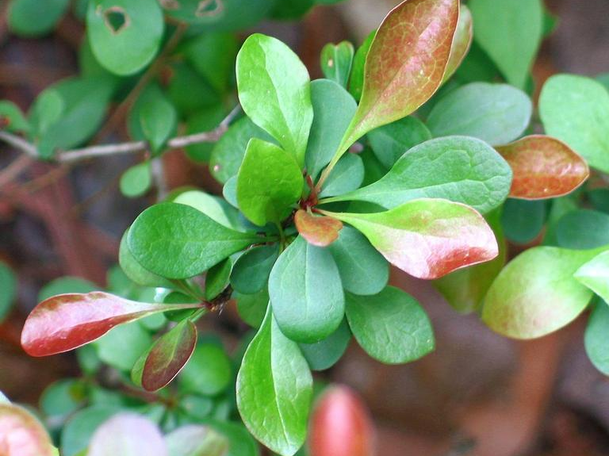
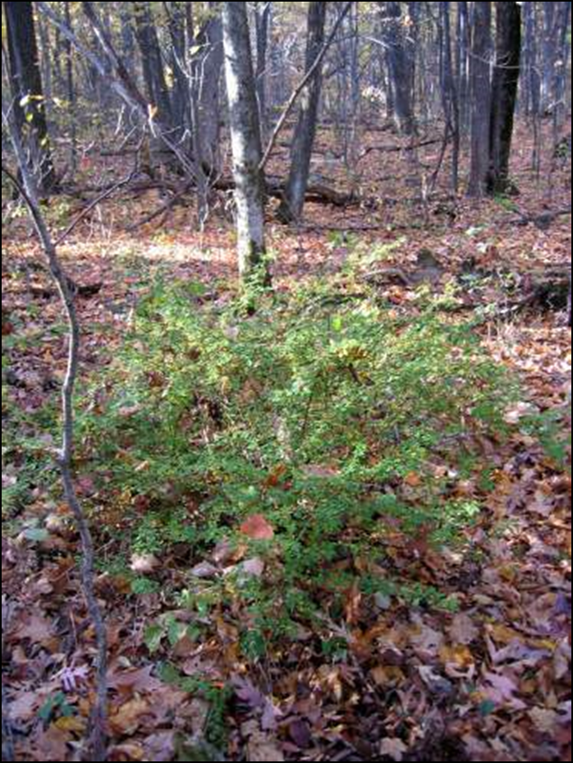
Japanese barberry
Berberis thunbergii
What makes it a successful invader?
It grows from seeds, sprouts from the root crown, sprouts from rhizomes, and arises from the rooting of long stems that touch the ground.
This species is very hardy -- population growth accelerates rapidly due to greater recruitment as density increases and it has low mortality rates.
Can survive in relatively undisturbed forest and in second-growth forests that were formerly cleared for agriculture or timber harvest, especially former pastures.
May grow under almost any shade level.
It leafs out earlier than associated species in closed-canopy deciduous forests
Notes:
Japanese barberry was introduced to the United States in the late 1800s as an ornamental plant and it is still used widely in cultivated landscapes, due in part becasue deer don’t typically eat it. Deer seem to find native plants more palatable, so we find lots of barberry in woodlands.
One of the reasons barberry is such a concern to landowners here stems from the fact that it has been implicated in the spread of Lyme disease. Higher densities of adult deer ticks and white-footed deer mice have been documented under barberry than under native shrubs. Deer mice under barberry bushes often have high levels of larval tick infestation and more of the adult ticks are infected with Lyme disease. When barberry is controlled, fewer mice and ticks are present and infection rates drop.
No matter what method you use to control Japanese barberry, you’ll need to monitor your site to make sure that treated plants don’t resprout and the seedbank is exhausted. The primary goal in controlling this species is to prevent seed production and dispersal. In general, plants in full sun produce more seed than those in shade and should be your first priority.
This species benefits from high nitrogen availability. It appears to have a complex relationship with non-native earthworms, which are associated with increased soil nitrification and break down litter rapidly. On sites where barberry is controlled, earthworm densities are reduced.
Common Name: Japanese barberry Family Name: Berberidaceae - Barberry family Native Range: Asia NJ Status: Widespread and highly threatening to native plant communities.
General Description
• Deciduous shrub from 2’ - 8’ • Branches are thin and grooved and covered in thin, straight spines
Leaves
• Alternate, tear-dropped shape • Ranging in color from bluish-green to green to dark reddish-purple
Flowers
• Small, fragrant, cream-colored borne on clusters along the stem • Bloom in April and May
Fruit
• Red egg-shaped, shiny, fleshy, berries 0.3 - 0.4” • Appears May and matures by October and remaining through winter
Habitat
• Roadsides, forest edges, open woods, ornamental plantings • Prefers partial shade to shade but tolerates full sun
Commercially Available
Yes
Look-alikes
European barberry (Berberis vulgaris)
• Also an invasive shrub with 3-pronged spines • Finely bristled leaf margins
American barberry (Berberis canadensis)
• Native shrub • Finely bristled leaf margins

Slide 19
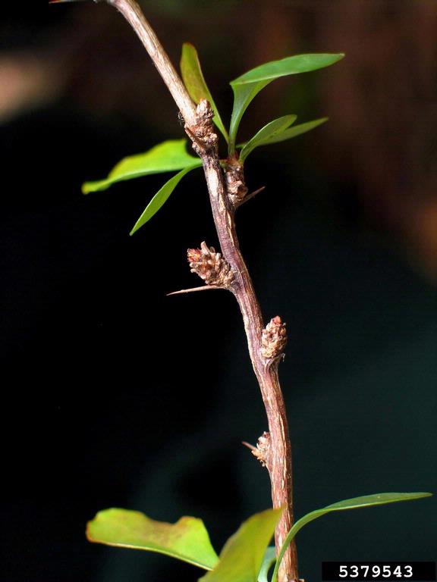
Japanese barberry
Berberis thunbergii
How can I control it?
Chemical:
Foliar Spray – FS 2
Glyphosate 3.00%
Basal Bark – BB1
Triclopyr Ester 25% OR
Pathfinder II ready-to-use mixture
Cut Stump – CS 1
Glyphosate 50%
Mechanical:
Pulling, grubbing-completely removing roots can work!
Notes:
Because Japanese barberry has shallow roots, you can control small infestations by pulling seedlings and little plants. Its sharp spines make wearing gloves a necessity. It is easiest to pull when the soil is moist; remove the root crown and as much of the roots as possible. Pull steadily and slowly to minimize soil disturbance and tamp down the soil afterwards. You’ll need to make sure that roots dry out completely, and if fruit is present, it should be burned or bagged and placed in a landfill.
If portions of the root crown are left, they may be able to resprout.
Cutting and mowing repeatedly may limit barberry’s spread but will not control it -- it will resprout from the root crown. Its spiny stems and arching branches make cutting difficult. Mowing can be used effectively as the first step of a two-part control effort when resprouts are treated with herbicide or even burned with a propane torch later in the season.
In terms of chemical treatment, Glyphosate (e.g., Roundup®, Rodeo®, Accord®) can provide effective control both as a foliar spray and for cut stump treatments. Foliar application is useful on dense thickets where natives aren’t present. Herbicide should be applied after periods of heavy sap flow in spring to actively growing plants. You should be aware that during periods of drought or other stress, it may not be effective.
Cut stump treatment is most effective while the plants are fully leafed and actively growing. When leaves are emerging and sap is flowing upward in the spring, it is not effective.
If you want to try basal bark treatment, the mixture we recommend can be applied throughout the year, even when snow is present, but it may be less effective in early spring when the sap is beginning to flow or during periods of drought in summer.
Ester formulations are particularly effective for root or stem sprouting species such as barberry because the triclopyr persists in the plant until it dies.

Slide 20
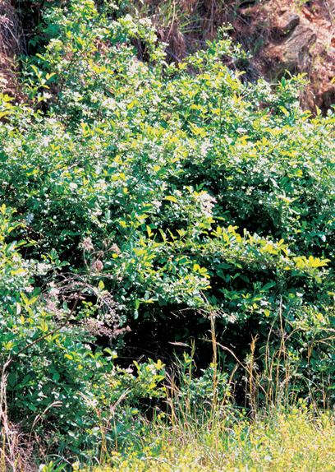
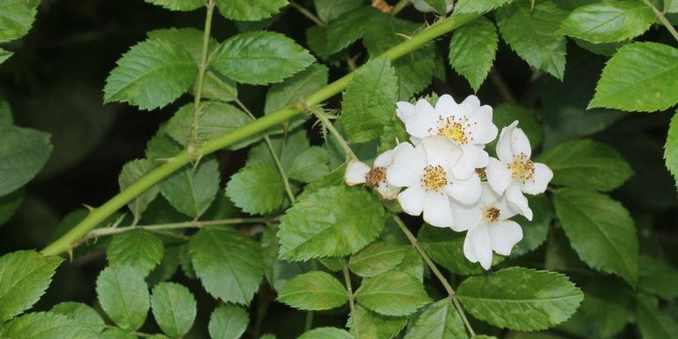
Multiflora rose
Rosa multiflora
What makes it a successful invader?
It tolerates a wide range of soil, moisture and light conditions.
It reproduces by seed and by forming new plants from the tips of arching canes that can root where they contact the ground.
An average plant produces an estimated one million seeds per year, which remain viable in the soil for up to 20 years.
Notes:
Multiflora rose was originally introduced to the East Coast in the late 1800’s as rootstock for cultivated roses, and it was later planted to control erosion.
As you well know, it is extremely prolific and can form dense thickets in a variety of habitats, including woodlands.

Slide 21
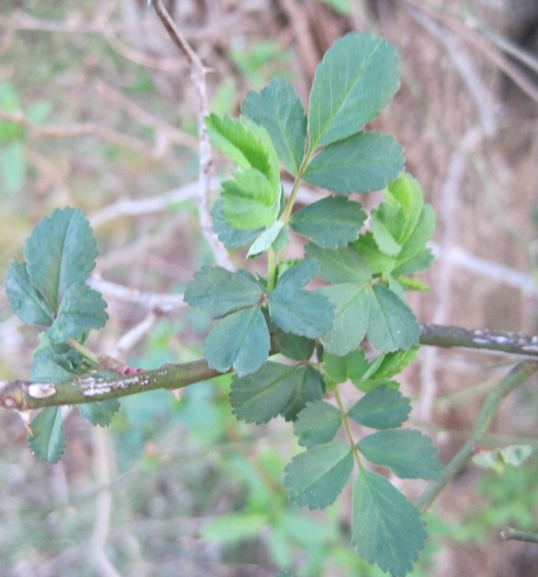
Multiflora rose
Rosa multiflora
How can I control it?
Chemical:
Foliar Spray – FS 2
Glyphosate 3.00%
Basal Bark – BB1
Triclopyr Ester 25% OR
Pathfinder II ready-to-use mixture
Cut Stump – CS 1
Glyphosate 50%
Mechanical:
Pulling, grubbing-completely removing roots – can work on light infestations.
Prescribed burning will hinder invasion & control spread.
Mowing, 3-6 cuttings/ growing season for 2-4 years.
Cutting is preferred over mowing in high quality communities
Notes:
In fire-adapted communities, a routine prescribed burn program will hinder invasion and establishment of multiflora rose.
Mechanical approaches can work when all the roots are removed – they are really only practical for light, scattered infestations.
If you want to try cutting or mowing, you’ll need to do that three to six times per growing season for two to four years, and be forewarned, mowing multiflora rose can result quickly in flat tires. Cutting is better in high quality areas, because repeated mowing will damage any native plants in the area. Increased mowing rates (more than six per season) does not increase plant mortality.
Chemical approaches run the gamut:
Glyphosate (Roundup) is an effective foliar spray on plants that are flowering or in bud. As always, you need to take care to avoid contacting non-target plants.
For basal bark, the best time for treatment is from late December to early April, before leaf bud expansion. A disadvantage to basal bark treatment is that it is difficult to do without being scratched by rose thorns.
Cut stump treatments kill the root system and prevent re-sprouting. Although the Roundup label recommends a concentration of 50 to 100%, the lower concentration has proven effective. Cut stump is best done late in the growing season (July through September), and also when the plants are dormant – that’s actually the preferred time because it will minimize potential harm to non-target species.
Humans are getting some help…
There are three insects that have the potential to reduce multiflora rose populations in the Northeast. They are the tortricid hip borer, which consumes parts of the flower; the rose seed chalcid, which destroys the seeds; and the raspberry cane borer, which kills the stems. The larvae in each case are responsible for the injury. In most circumstances, however, these insects aren’t present in sufficient quantity to eliminate a multiflora rose infestation.
Several pathogens are associated with multiflora rose. The most promising one is known as rose rosette disease (RRD). It’s a virus spread by a mite. The first symptom is a bright-red and dark-red mosaic pattern on new leaves, and it appears within 30 days of initial infection. Within about three months, the plant will begin to produce lots and lots of lateral shoots. They are usually bright red and they form dense clusters called witches’ brooms. In winter the infected plants are susceptible to heavy frost damage. The following spring, the plants will have red lateral shoots and thick clusters of small, reddish-green leaves. Within two years of infection, the entire plant, including the root system, will die.
Only certain members of the rose family are susceptible to RRD. Some ornamental rose varieties are also affected, although many appear less sensitive than multiflora rose.
RRD has spread to the East from its origins in the Midwest. As with most biocontrol agents, the mite is quite sensitive to changes in the environment, so it may be some time before it spreads throughout the Northeast. Then it will take awhile for plants to become infected and die. While RRD may not eradicate the multiflora rose problem, it should help reduce it over the long run.
Now, we’d like to turn your attention to lesser known invasive species and introduce you to a representative sampling of some of the emerging species.

Slide 22
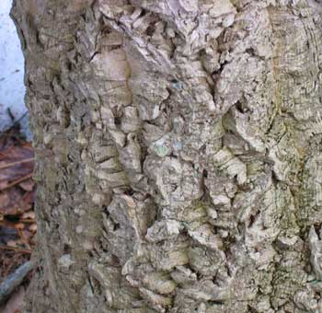
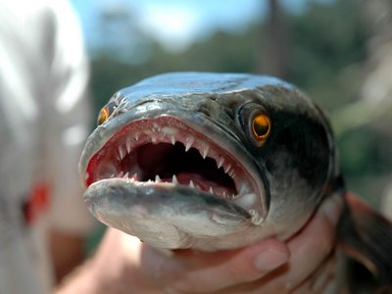
Species on the Move
Northern Snakehead
Stage 0 → Stage 1
Amur Corktree
Stage 0 → Stage 1
Notes:
Invasive species are always on the move. In recent years, the northern snakehead has gone from Stage 0 to 3 and the Amur corktree has gone from Stage 0 to 1.

Slide 23
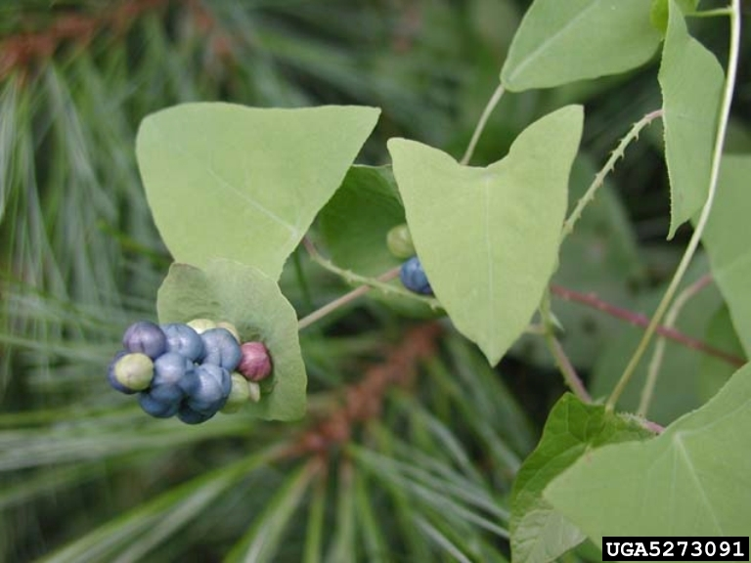
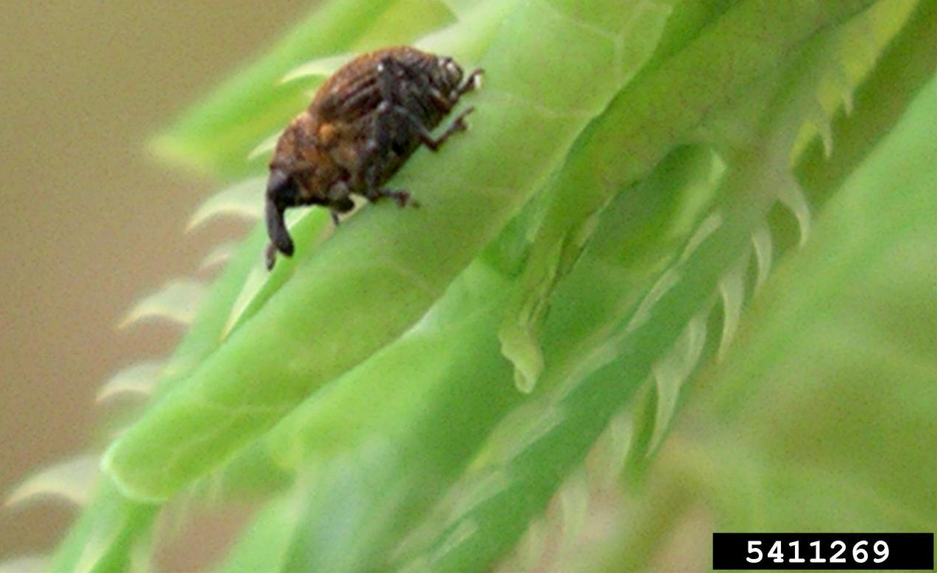
Species on the Move
Mile-a-Minute
Stage 3 → Widespread
Notes:
Mile-a-Minute is a vine that went from a Stage 3 species to a widespread species. The good news in the case of this invader is that weevils like the one pictured here have been deployed by the State and they are helping to slow the spread of Mile-a-Minute. The use of biocontrol agents is not without controversy, but we are hopeful that the testing done by scientists before the weevils (which are not native to New Jersey) were released was sufficient to ensure that the weevils will not decimate native plants as they spread across areas infested with Mile-a-Minute.

Slide 24
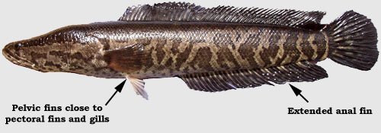
Northern Snakehead (Channa argus)
Stage 1 – Shallow ponds, swamps, slow streams, canals, rivers and lakes
Notes:
The northern snakehead is a voracious apex predator with few, if any, natural enemies. It has the potential to severely impact native fish, crustaceans, insects and other biota.
The fish is an obligate air breather – it can breathe air and survive for up to four days out of water, and can survive for longer periods of time when it burrows in mud. Once a habitat is no longer suitable and prey populations have been decimated, snakehead are capable of dispersing overland to exploit new environments.
Common Name: northern snakehead Family Name: Channidae - Freshwater perciform fish family Species Code: CHAR1 Native Range: China, possibly Korea and Russia NJ Status: Emerging Stage 1 – Rare (may be locally common). It is highly threatening to native communities.
• Reaches sexual maturity by age 2 or 3. • Each spawning-age female can release up to 15,000 eggs at once. • Mate as often as five times a year. • In 2 years a single female can release up to 150,000 eggs.
• Obligate air breathers
General Description
• Has a wider latitudinal range and temperature tolerance than other species. • A long, thin body that can grow to 47” and up to 15lbs. • Head - Scaled, somewhat flattened with eyes located in a dorsolateral position on the anterior, large mouth, sharp teeth and protruding lower jaw. • Tubular anterior nostrils • Elongated dorsal and anal fins • Truncated tail • Younger fish may be gold-tinted brown to pale gray in color • Older fish are generally dark brown with large black blotches. • If wet, they can survive on land for up to four days • Known to migrate up to 1/4 mile on wet land to other bodies of water
Life Cycle
• Reaches sexual maturity by age 2 or 3. • Each spawning-age female can release up to 15,000 eggs at once. • Mate as often as five times a year. • In 2 years a single female can release up to 150,000 eggs.
Habitat
• Stagnant shallow ponds or swamps with mud substrate and aquatic vegetation • Slow muddy streams • Canals, reservoirs, lakes and rivers • Obligate air breathers
Look-alikes
burbot (Lota lota)
• Native • Split dorsal fin and a single barbell on the lower jaw.
Bowfin (Amia calva)
• Rounded tail, no scales on its head • Eyespot near the tail in males.
24

Slide 25
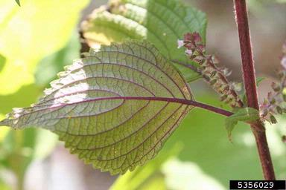
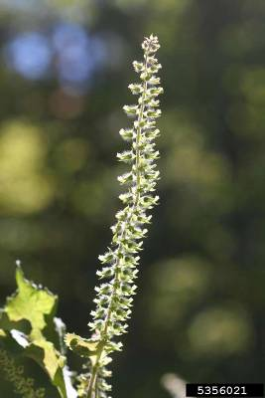
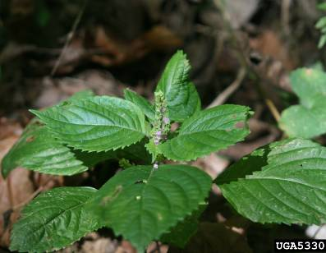
Beefsteakplant (Perilla frutescens)
Stage 1 – Shaded roadsides, riparian areas, forests, gardens
Notes:
Beefsteak plant is a traditional Asian crop used in cooking and is often planted as an ornamental. It readily escapes cultivation and has become invasive in natural areas across the mid-Atlantic region.
It is especially troublesome in natural areas that have experienced some form of disturbance. It has toxic characteristics which may explain why very few herbivores feed on it.
Stage 1. We recommend using a foliar spray or pre-emergent treatment to control it.
• Annual herb to 0.5’ - 1.5’
• Dried stalks can persist through winter
• Stems square
• Strongly aromatic, some claim it smells like raw beef
Control Recommendations - treat before fruit/seed maturation
Foliar Spray: FS-2
• Glyphosate 3.00%
• Please see our Herbicide Use Suggestions and Mixing Guide for more information
Pre-Emergent Spray: PE-1
• Prodiamine - See Label Instructions
Leaves
• Opposite, broadly oval to oblong
• 3” - 6” long, including the long stem
• Toothed
• Veins point towards the leaf tip
• Typically purple to purplish green, especially below
• Leaf base wedge shaped
Flowers
• Small, purplish to white
• Appearing in terminal or axillary spikes
• Irregular flowers
• Paired along the spike
• Surrounded by straight, outwardly spreading bracts—bracts typically not taller than the flower cluster
• Blooms August-September
Fruit
• Tiny, oval, dark seeds contained within hairy leaf-like structures
• Borne on a spike, 2” - 5” long
Habitat
• Shaded roadsides, riparian areas, forests, gardens
• Moist ground
Commercially Available
Yes
Look-alikes
The strong odor, leaf shape and color distinguish Perilla frutescens from members of the mint family and other squared stemmed plants.
ater-horehound and bugleweed species (Lycopus spp.)
• Native and non-native perennial herbs of moist or wet ground
• Native species can be frequent
• Purplish flowers typically in axillary clusters
• Leaves typically narrower
• Faint odor
horse-balm (Collinsonia canadensis)
• Native woodland wildflower
• Flowers yellow
• Strong odor of citronella
American germander (Teucrium canadense)
• Native wildflower of thickets and moist ground
• Flowers purplish
• Stamens protrude
• Leaves elongate
25

Slide 26
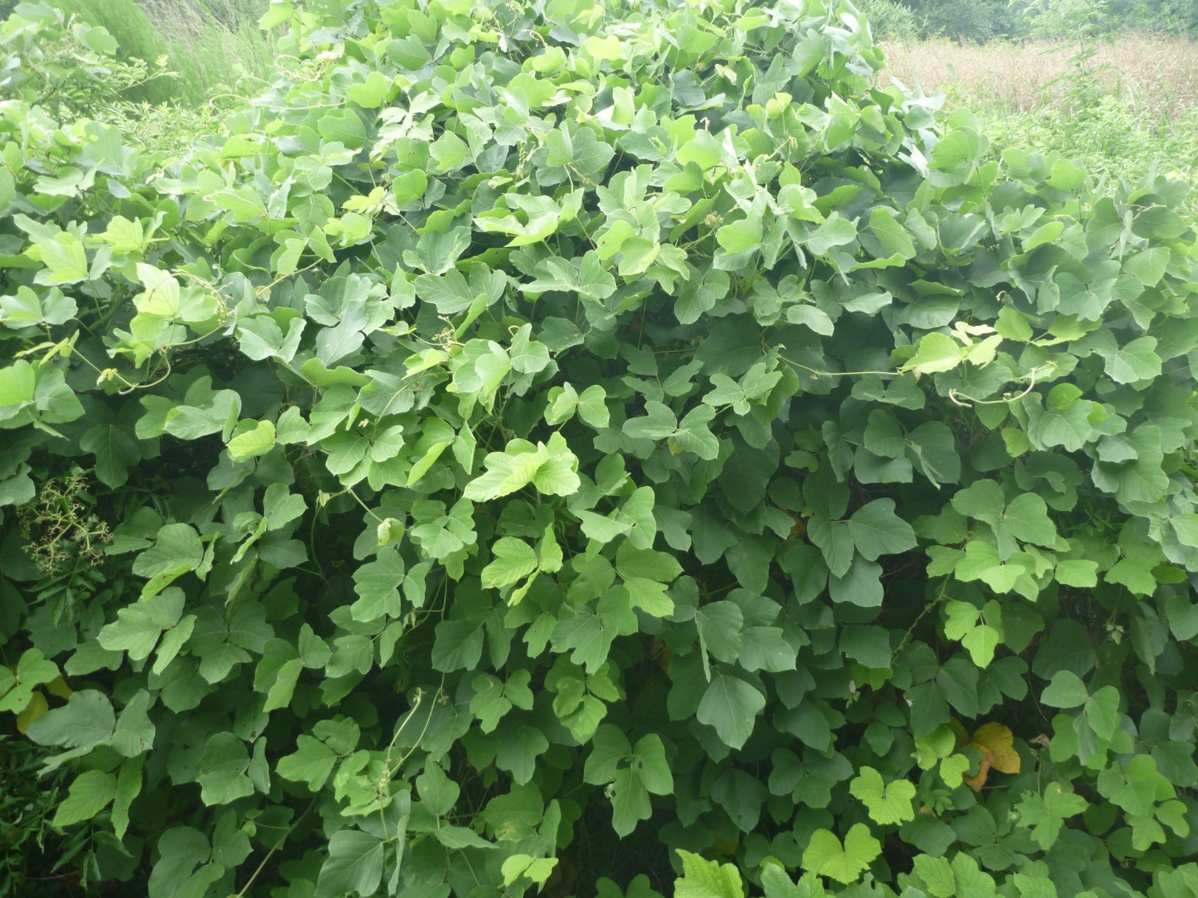
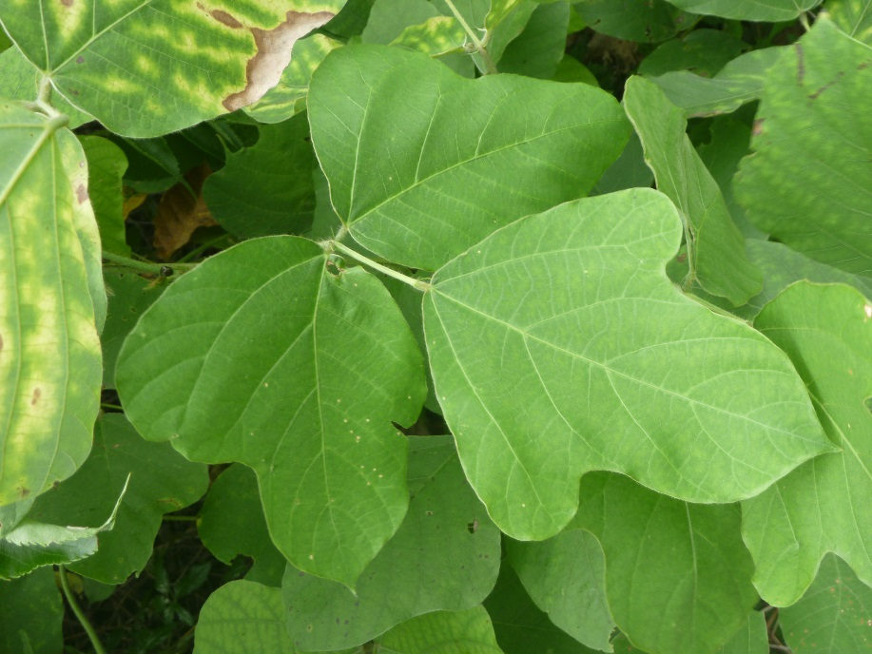
Kudzu (Pueraria montana)
Stage 1 - Forest edges, meadows, abandoned fields, roadsides, dams
Notes:
Kudzu was introduced to the United States from Japan in 1876 at the Philadelphia Centennial Exposition, as an ornamental plant. Later it was used a forage crop throughout the southeast and by the 1930s southern farmers were being paid to plant kudzu to reduce soil erosion… over 1 million acres were planted.
Kudzu can kill trees by girdling them, and the extra weight of the vines can also topple them during storms. Once its established, kudzu plants grow very quickly, about 1 foot per day.
Stage 1 - We recommend using a foliar spray or basal bark treatment to control it.
Climbing or trailing semi-woody perennial vine • Up to 100’ long • Stems up to 2” thick • Fleshy tap root up to 7” wide and 9’ deep, weighing 400 lbs.
Control Recommendations
Foliar Spray: FS-1
• Glyphosate 3.75%, Triclopyr Amine 2.50% • Please see our Herbicide Use Suggestions and Mixing Guide for more information
Basal Bark: BB-1
• Triclopyr Ester 25% OR Pathfinder II ready-to-use mixture • Please see our Herbicide Use Suggestions and Mixing Guide for more information • Pre-treatment cutting is recommended when tall/dense/multi-stem tangles prohibit safe application via foliar spray • Species has thick/waxy leaves -- utlilize Clean Cut surfactant or equivalent
Leaves
• Alternate, compound • 3 oval leaflets up to 4” wide • Untoothed • Leaflet shape variable — can be tear drop shaped or lobed • Leaf edges hairy
Flowers
• Fragrant, pea-like, purple • Borne in long clusters • Blooms August-early September
Fruit
• Brown, hairy, flattened seed pods about 8” long • Each pod contains 3 - 10 hard seeds. • Ripening in September to October
Habitat
• Forest edge, meadow, abandoned fields, roadside, dams • Fast growing • Once planted for erosion control
Commercially Available
Not found, Federal Noxious Weed
Look-alikes
There are numerous native climbing pea-like vines, but none are as vigorous or large as kudzu.
trailing wild bean (Strophostyles helvola)
• Annual to 4’ tall • Flowers less showy, greenish-purple to pink • Leaves oval, sometimes with concave edges, like kudzu • Fruits bean-like, 1.5” - 4” long • Damp thickets and shores

Slide 27
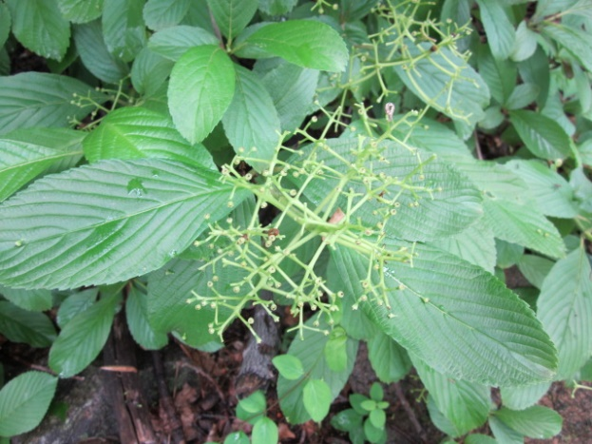
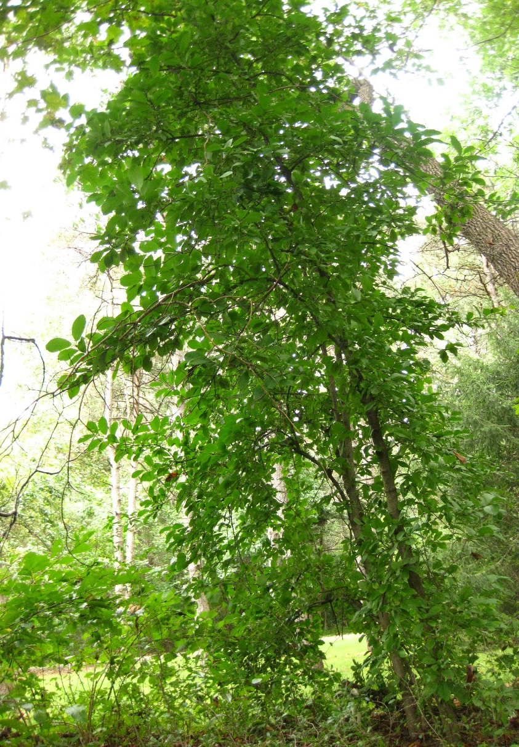
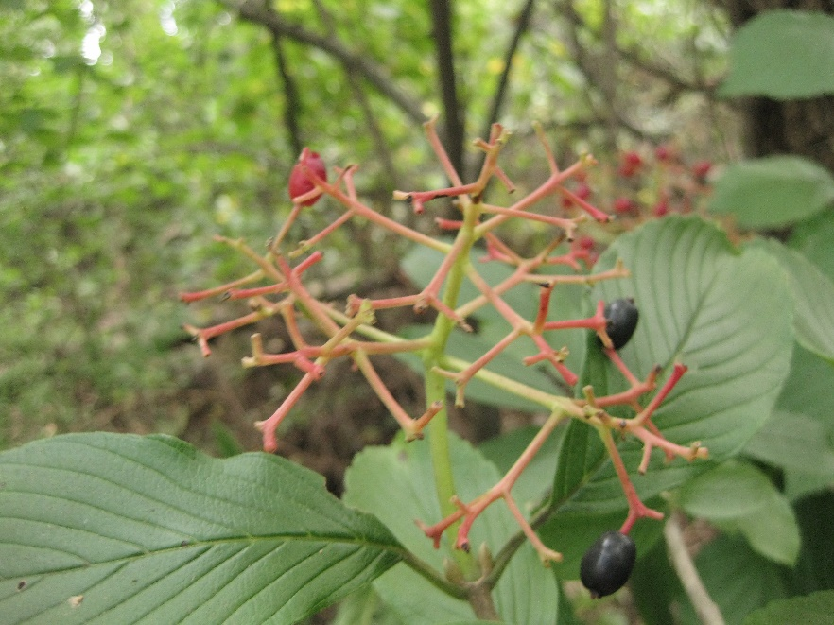
Siebold’s viburnum (Viburnum sieboldii)
Stage 2 – Forests, edges, hedgerows, cultivated landscapes
Notes:
This native of Japan was brought to the U.S. as an ornamental landscape plant. Many cultivars are still sold in the nursery trade.
It is a large shrub or small tree can grow up to 20 feet tall and about half as wide. Some people perceive the smell of burnt rubber when its leaves are bruised.
It’s a Stage 2 species. We recommend using a foliar spray or basal bark treatment to control it.
Common Name: Siebold’s viburnum, Siebold’s arrowwood Family Name: Adoxaceae - Adoxa family Native Range: Japan NJ Status: Emerging Stage 2 – Uncommon (may be regionally common or abundant). It is highly threatening to native communities.
General Description
• Deciduous large shrub or small tree • 15’ - 20’ tall and 10’ - 15’ wide • Stout branching and large buds
Control Recommendations
Foliar Spray: FS-1
• Glyphosate 3.75%, Triclopyr Amine 2.50% • Please see our Herbicide Use Suggestions and Mixing Guide for more information • This species resprouts strongly, so cutting is not recommended
Basal Bark: BB-1
• Triclopyr Ester 25% OR Pathfinder II ready-to-use mixture • Please see our Herbicide Use Suggestions and Mixing Guide for more information • Apply from July through September to enhance effectiveness
Leaves
• Opposite and coarsely toothed • Oval shaped 2” - 5” long • Thick, dark, leathery leaves, deeply veined • Leaf veins & leaf stems covered in downy hairs • Crushed leaves may emit foul odor (burnt rubber or skunk)
Flowers
• Small, off-white • 5 petals on each tiny flower • Borne on flat-topped clusters 3” - 6”across • Blooms in late May
Fruit
• Oval, single seeded fruits borne in clusters • Maturing from red to black • Fruit borne on bright red stems • Appearing August - September
Habitat
• Forest, open forest, edge, hedgerow, landscaping • Shade tolerant
Commercially Available
Yes
Look-alikes
The Viburnum species are best differentiated by leaf shape, fruit color, buds, and flower and fruit structure.
leatherleaf viburnum (Viburnum rhytidophyllum)
• Non-native shrub, potentially invasive • Evergreen • Twigs, leaves & stems are hairy • Untoothed leaves • Very wrinkled leaf surface • Similar flower
blackhaw (Viburnum prunifolium)
• Native shrub/ small tree • Opposite, finely toothed leaves with upcurved fine veins • Leaves 1.5” - 3.5”, NOT leathery • Blue berries occur in clusters • Showy white flowers
For additional look-alikes, see factsheets for:
linden viburnum (V. dilatatum), doublefile viburnum (V. plicatum), wayfaring tree (V. lantana), tea viburnum (V. setigerum)

Slide 28
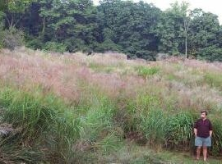
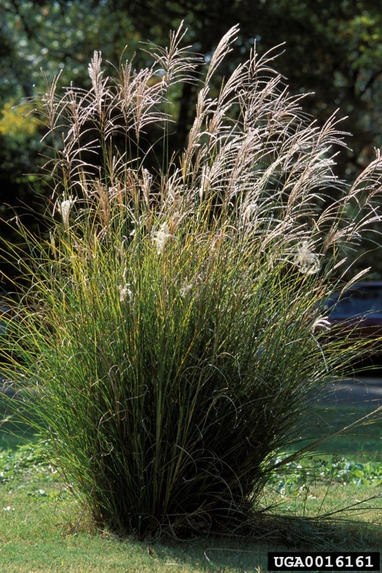
Chinese silver grass (Miscanthus sinensis)
Stage 2 - Forest edges, meadows, coastal areas, roadsides
Notes:
This grass was brought to the U.S. from Asia in the late 1800s as an ornamental landscape plant. It is also referred to as Eulalia, zebra grass and Miscanthus.
Chinese silvergrass can escape from landscape plantings into natural areas, particularly disturbed sites, where it displaces native vegetation. It is extremely flammable, so the risk of wildfires increases in areas with this grass.
• Tall, clump-forming, perennial grass • 6.5’ - 10’ tall • Spreads by seed and strong root system • Widely planted as an ornamental • Variable—over 50 cultivars available
Leaves
• Long,thin, 3’ - 6’ long sharply pointed tips • Leaf edges very rough • Stiff, upright, with tips sometimes curving down • Often with a silvery white midrib • Cultivars can vary in leaf color • Leaves dry and persist through winter
Flowers
• Showy, silvery to pale pink flowers (panicles) • Fan-shaped, multiple spikes make up each head • Individual flowers 2.75” - 3.5” wide • Blooms late September-November
Fruit
• Small with a twisted, bristled tip • Ripening in September- October • Persisting through winter
Habitat
• Forest edge, meadow, coastal areas, roadside, garden, landscaping • Tolerates extremes in soil moisture, from dry to moist
Commercially Available
Yes, many cultivars available
Look-alikes
Eastern gamagrass (Tripsacum dactyloides)
• Large, clumping native grass to 10’ or taller • Not showy, 1 - 4 flowering spikes, 4” - 9” long • Seeds large, chunky, like corn kernels • White midrib • Swamps, meadows, wet shores
Control Recommendations
Foliar Spray: FS-3
• Glyphosate 5.00% • Conduct in late August through September to enhance effectiveness • Please see our Herbicide Use Suggestions and Mixing Guide for more information.
28

Slide 29
Japanese & Chinese wisteria (Wisteria floribunda & sinensis)
Stage 2 and 3 -
Roadsides, forest edges, open woods, stream edges, meadows
Notes:
The alien wisterias are deciduous woody vines with purple flowers that bloom if the plants are in full sunlight when they are mature. They twine up trees and send out runners that travel along the ground and make up a very dense root network.
Stage 2 and 3. We recommend using a foliar spray or basal bark treatment to control them.
General Description
• Deciduous woody vine • Smooth light gray bark • Can reach heights of 40’ and grow 10’ wide • Mature stem is fluted, muscle-like • Twines up counter-clockwise • Sends out a large amount of “runners,” vines that travel along the ground making a very dense root network
Control Recommendations
Foliar Spray: FS-1
• Glyphosate 3.75%, Triclopyr Amine 2.50% • Please see our Herbicide Use Suggestions and Mixing Guide for more information
Basal Bark: BB-1
• Triclopyr Ester 25% OR Pathfinder II ready-to-use mixture • Please see our Herbicide Use Suggestions and Mixing Guide for more information • Pre-treatment cutting is recommended when tall/dense/multi-stem tangles prohibit safe application via foliar spray • Species has thick/waxy leaves -- utlilize Clean Cut surfactant or equivalent
Leaves
• Alternate leaves, pinnately compound with a terminal leaf • Leaves are 4-16” • There are 13-19 leaflets, each 3” long
Flowers
• Blooms mid-May, but only when it is mature and in full sunlight • Lavender, purple, or white hanging clusters • All flowers open simultaneously • 6-20” long
Fruit
• Bean-like pods, 4-6” long • Green and hairy, turns brown and cracks when mature
Habitat
• Prefers moist soil, shade tolerant • Roadsides, forest edge, open woods, stream edges, meadows, gardens, and landscaping
Commercially Available
Yes
Look-alikes
America Wisteria (Wisteria frutescens)
• Native vine of Southeast, introduced further north • Leaves 4”-12” long • 9-15 leaflets, each 0.75”-2.5” long • Not fragrant, inflorescences 4”-10” long • Blooms June-August • Hairless seed pod
Trumpet Vine (Campsis radicans)
• Native vine of Southeast, introduced further north • Opposite and pinnately compound leaves, serrated • Blooms in late spring through early summer with orange-red elongated flowers

Slide 30
Oriental Photinia (Photinia villosa)
Stage 3 - Forests, floodplains, cultivated landscapes
Notes:
Sometimes Mother Nature can fool those who don't look closely enough. Oriental photnina looks a lot like red chokeberry, which is native.
They have similar flowers--both are in the rose family--but the Red Chokeberry blooms in late April to early May, while Photinia blossums open in mid to late May.
The petiole (segment connecting leaf to stem) is 1/8th inch on Photinia, longer on Chokeberry. The pattern of leaf veins is also different.
Emerging Stage 3. We recommend using a foliar spray or basal bark treatment to control it.
Common Name: Oriental photinia Family Name: Rosaceae - Rose family Native Range: Asia NJ Status: Emerging Stage 3 – Common (may be regionally abundant). It is highly threatening native plant communities.
General Description
• Colonial, fast growing and shade tolerant • Deciduous shrub or small tree to 20’ • Multiple stems or single trunk • Smooth, gray bark
Leaves
• Alternate, oval-shaped, widening at the tip, finely toothed • Typically stemless • Smooth above, long-haired beneath • Turn red-orange to golden in autumn
Flowers
• White, 5 petals • Blooms late May - June • Green maturing to red in early autumn • Round, 0.5” wide or smaller • 1 - 4 seeds in each fruit
Habitat
• Forests, floodplains, landscaping • Full or partial shade
Commercially Available
Not found currently, but historically available
Look-alikes
red chokeberry (Photinia arbutifolia); black chokeberry (Photinia melanocarpa)
• Native shrubs up to 9’ • Clusters of round, red (P. arbutifolia) to purple-black fruit (P. melanocarpa), maturing in autumn • Foliage turns red in fall • Leaves similar shape and size to Oriental photinia, but chokeberries have a short stem, 0.25” long
serviceberry (Amelanchier spp.)
• Native shrubs or small trees from 6’ to 50’ • Forests, thickets, roadsides • 5 petalled white flowers, April - May • Leaf varies by species, typically tapers gradually at tip and wide and somewhat indented at base • Fruit red, maturing in June
Control Recommendations
Foliar Spray: FS-1
• Glyphosate 3.75%, Triclopyr Amine 2.50% • Please see our Herbicide Use Suggestions and Mixing Guide for more information • This species resprouts strongly, so cutting is not recommended
Basal Bark: BB-1
• Triclopyr Ester 25% OR Pathfinder II ready-to-use mixture • Please see our Herbicide Use Suggestions and Mixing Guide for more information • Apply from July through September to enhance effectiveness

Slide 31
Water Chestnut (Trapa natans)
Stage 3 - Ponds, lakes, rivers & streams
Notes:
Trapa natans is a rooted, floating plant that invades shallow to deep, fresh water habitats. It can form dense, floating mats on the surface of the water and thereby restrict light availability, reduce the oxygen content, and displace other emergent and floating vegetation. It limits boating, fishing, swimming and other recreational activities.
Common Name: water chestnut
Family Name: Trapaceae - Water chestnut family
Native Range: Eurasia
NJ Status: Emerging Stage 3 – Common (may be regionally abundant). It is highly threatening native communities.
General Description
• Rooted aquatic • Annual—after frost plants die • Mat-forming • Easily hand-pulled • Displays explosive growth
Leaves
• Floating rosette of triangular, sharply toothed leaves, 0.75”-1.5” long • Stems up to 6” long with swollen portions that give buoyancy • Prominently veined with short, stiff hairs below • Feathery submerged leaves up to 6” long, opposite or nearly so
Flowers
• Tiny, white, 4 petals • Appear in center of the rosette • Blooms from July until a killing frost
Fruit
• Submerged, 1” wide nut-like structures with 4 barbed spines • Ripening in August until a killing frost • Viable for up to 12 years • Spines can pierce paws of pets and wildlife, as well as the feet of swimmers • Dispersed by water current, boats, and wildlife
Habitat
• Ponds, lakes, rivers, streams • Most often found in slow-moving, nutrient rich waters • Decay of plant material can deplete oxygen for fish and other organisms
Commercially Available
No
Look-alikes
None
Control Recommendations
• Treatment options may include herbicide (often for several consecutive years), hand-pulling, mechanical raking and dredging • Requires special permitting for herbicide application • Use wetland appropriate herbicide applied by professional lake managers • Must treat before fruit/seed maturation
31

Slide 32
Japanese angelica tree (Aralia elata)
Stage 3 - Forests, shrublands, meadows, cultivated landscapes
Notes:
32
Japanese angelica tree is a member of the ginseng family and was introduced here as an ornamental plant.
It’s a fairly small tree – it can get to about 40 feet tall, and it grows rapidly in full to partial. It looks a lot like Devil’s walking stick, which is native, and it can be very challenging to tell them apart. The best strategy is to wait they flower. The base of the flower stalk of Devil’s walking stick is long and stretched out; Japanese angelica has a very short axis and the flower stalk abruptly from the top of the trunk.
Stage 3 species. We recommend using a foliar spray or basal bark treatment to control it.
Common Name: Japanese angelica tree, Japanese aralia Family Name: Araliaceae - Aralia family Native Range: Asia NJ Status: Emerging Stage 3 – Common (may be regionally abundant). It is highly threatening native plant communities.
General Description
• Deciduous tree or shrub, to 40’ tall • Colonial, thicket forming • Irregular form, spreading, multi or single stemmed • Bark covered in sharp prickles
Control Recommendations
Foliar Spray: FS-1
• Glyphosate 3.75%, Triclopyr Amine 2.50% • Please see our Herbicide Use Suggestions and Mixing Guide for more information • This species resprouts strongly, so cutting is not recommended
Basal Bark: BB-1
• Triclopyr Ester 25% OR Pathfinder II ready-to-use mixture • Please see our Herbicide Use Suggestions and Mixing Guide for more information • Apply from July through September to enhance effectiveness
Leaves
• Alternate, 2 or 3 times pinnately compound • Toothed or nearly toothless with downy hairs below • Leaflets variable, 2” - 4.75” long • Large, entire leaf 2’ - 4’ feet long • Leaves turn yellow to reddish purple in fall • Spines at leaf axils • Main leaf veins extend to leaf edge • Leaflet typically with sessile or with very short petiole (stem)
Flowers
• Whitish to cream colored • Borne in large, inflorescence 12” - 24” long • Clusters multi-stemmed, lacking a central axis • Often wider than tall, with flower base surrounded or over topped by foliage • Blooms late July - August
Fruit
• Small purple to black berries in circular formations • Appearing August - September; ripening from September - October
Habitat
• Forest, shrub land, meadow, and landscaping
Commercially Available
Yes
Look-alikes
devil’s walking stick (Aralia spinosa)
• Small native tree or shrub • Inflorescence longer, 3’ - 3.5’ with a distinct central stalk • Typically taller than wide, usually above foliage • Main leaf veins branch and diminish at leaf margin • Leaflets variable, 2” - 2.75” long • Typically with short, but distinct petiole • Typically southern, extends into PA, DE
toothache tree, common prickly ash (Zanthoxylum americanum)
• Small native tree or shrub • Prickles paired along stem • Compound leaves • Blooms in spring, before leaf out

Slide 33
Flathead catfish (Pylodictis olivaris)
Stage 3 - Deep, slow moving water ways
Notes:
33
As the common name suggests, this catfish has a flat head, but other than that, it looks like any other catfish: it has smooth, scaleless skin, whisker-like barbels around the mouth, and long spines on the dorsal (back) fin and one on each side of the pectoral (shoulder) fin. Flathead catfish reach a length of 3 to 4 feet and their weight can exceed 100 pounds.
Unlike other catfish which are scavengers, flatheads prey only on live fish. Young flathead catfish feed mostly on invertebrates such as worms, insects and crayfish. When 10 inches or larger, their diet consists entirely of fish: shad, carp, suckers, sunfish, largemouth bass and other catfish (including their own kind).
Common Name: flathead catfish, yellow cat, mud cat, shovelhead cat Family Name: Ictaluridae - Catfish family Species Code: PYOL1 Native Range: Central United States NJ Status: Emerging Stage 3 – Common (may be regionally abundant). It is highly threatening native communities. General Description
• Broad, flat head with small eyes. • Lower jaw extends past upper jaw. • Olive colored back, dark brown sides with yellow-brown mottling, and yellow-white belly. • Squared tail fin • 18-24” long, can weigh up to 100lbs
Life Cycle
• Reach sexual maturity between 3-6 years • Spawing between May and August, with water tempteratures 75-80 °F • Eggs laid in shallow water, male guards the nest aggressively.
Habitat
• Deep, slow moving water ways • Prefer lots of debris
Look-alikes
bullheaded catfish (Ameiurus spp.)
• Three species brown bullhead (A. nebulosus), yellow bullhead (A. natalis), and black bullhead (A. melas). • Similar coloring to P. olivaris • Tail fin can be squared or rounded • Upper jaw longer then lower jaw • All Ameiurus spp. lack the flat head and small eyes of P. olivaris

Slide 34
English ivy (Hedera helix)
Stage 3 - Forest, edge, field, coastal areas
Notes:
34
English ivy is undoubtedly familiar to you. It is a concern because it can smother shrubs and trees and also because it serves as a reservoir for Bacterial Leaf Scorch (Xylella fastidiosa), a pathogen that is harmful to native trees.
It is a Stage 3 species. We recommend using a foliar spray or basal bark treatment to control it.
• Perennial, climbing, evergreen vine or groundcover • Climbs using small, sticky root-like structures • Can smother shrubs and trees • Older vines can grow to 1” in diameter
Control Recommendations
Foliar Spray: FS-1
• Glyphosate 3.75%, Triclopyr Amine 2.50% • Please see our Herbicide Use Suggestions and Mixing Guide for more information
Basal Bark: BB-1
• Triclopyr Ester 25% OR Pathfinder II ready-to-use mixture • Please see our Herbicide Use Suggestions and Mixing Guide for more information • Pre-treatment cutting is recommended when tall/dense/multi-stem tangles prohibit safe application via foliar spray • Species has thick/waxy leaves -- utlilize Clean Cut surfactant or equivalent
Leaves
• Alternate, dark green with white veins • Waxy or leathery • No toothing on edges • Usually 3 - 5 lobes per leaf - leaves may appear triangular • Mature, flowering plants may have unlobed rounded or heart shaped leaves • Many cultivars are available making leaf color variable- may be edged in white, reddish, or yellowish
Flowers
• Small, pale yellow-green • Borne on terminal clusters • Blooms August - September • Flowering triggered by sunlight (often requires climbing to flower) • Vines may grow for up to 10 years before flowering
Fruit
• Black to purple fruits • Thin fleshy outer covering • 1 - 3 hard seeds • Ripening October – November
Habitat
• Forest, edge, field, coastal area, garden • Prefers drier sites • Highly invasive in warmer climates
Commercially Available
Yes
Look-alikes
Boston ivy (Parthenocissus tricuspidata)
• Highly invasive climbing vine or groundcover • Deciduous- reddish fall color • Leaves are bright, glossy green • Toothed edge • See NJISST fact sheet for more on this plant
poison ivy (Toxicodendron radicans)
• Native deciduous vine • White berries • Leaves in groups of 3, may have reddish tinge • Hairy stems

Slide 35
Yellow iris (Iris pseudoacorus)
Stage 3 - Floodplain forest, marsh, wet meadow, shorelines
Notes:
Iris pseudacorusis a wetland plant that is especially showy during its short blooming period. It has been transplanted into water gardens all over the world and has widely escaped. It colonizes into large numbers, forming very dense monotypic stands and outcompetes other plants.
Herbaceous clump-forming perennial • 3’-4’ tall • Strong roots, that are pink in color
Leaves
• Broad, sword-shaped, emanating from a central base • About 1.6’-3.3’ long • Stiff, upright • Glaucous (waxy coating)
Flowers
• Showy, bright yellow, (occasionally whitish to cream-colored) • Multiple flowers grow on each stem • Individual flowers 2.75”-3.5” wide • Blooms late April-June
Fruit
• 6-angled seed capsule containing up to 120 seeds • Mature capsule opens into 3 widely spreading segments • Seeds mature from white to brown • Ripens in July-August
Habitat
• Floodplain forest, marsh, wet meadow, shores • Tolerates water up to 10” deep • Tolerates salt, drought and some pollution
Commercially Available
Yes
Look-alikes
northern blue flag iris (Iris versicolor)
• Native iris • Purple to blue flower, with a small yellow patch on sepals • Fruit capsules are 3-angled, remaining closed at maturity • Roots not pink
German iris (Iris germanica)
• Non-native iris, occasionally escaped • Flowers variable in size and color, but petals always bearded (fuzzy) • Fruit capsules are 3-angled, remaining closed at maturity
Control Recommendations
Foliar Spray: FS-3
• Glyphosate 5.00% • Please see our Herbicide Use Suggestions and Mixing Guide for more information • Plants are sterile and do not produce viable seeds • As necessary, seek aquatic application permit and use wetlands-appropriate herbicides and surfactants
35

Slide 36
Callery (bradford) pear (Pyrus calleryana)
Stage 3 – Forest edges, meadows, roadsides
Notes:
36
Native to China and Taiwan, callery pear has been a hot landscaping plant for decades. The cultivated forms were thought to be sterile, but they have a big flaw –they have a weak branch structure which means that the branches eventually split and kill the tree. Because of that, horticulturists developed other cultivars with better branch structure. Over time, many other cultivars were released and used in landscaping. Each one of those cultivars is genetically different from the other cultivars, which means they can cross with each other and produce fruits. Lots and lots of fruits. Which means lots and lots of trees. And for our forests, much less diversity as callery pear invades.
Callery pear is also a popular root stock for grafting other pears. If the grafted pear dies, the callery pear root stock will continue to grow and will produce abundant fruits.
• Deciduous tree to 45’ tall • Pyramidal to “lollipop” form • Young bark smooth with horizontal lenticels • Older bark shows vertical fissures • Large terminal buds, 0.5" long and extremely hairy • Branches tend to split from tree • Numerous cultivars
Leaves
• Alternate, oval, finely toothed • Glossy, leathery, dark green, wavy edge • 2" - 3" long and almost as wide • Stem 2” long • Turning red, purple and orange in fall
Flowers
• White with 5 petals, about 0.75” wide • Showy clusters 3” in diameter • Peak blooms late March through April before leaf out • Slightly malodorous
Fruit
• Round, 0.5” across • Olive-brown to tan with reddish to tan specks • Ripening in September - October
Habitat
• Meadow, roadside, forest edge, garden, landscaping • Widely planted as an ornamental
Commercially Available
Yes
Look-alikes
Cultivated apple (Malus spp.) and pear (Pyrus spp.) are similar to Callery pear, but can be differentiated by their fruits
Control Recommendations
Foliar Spray: FS-1
• Glyphosate 3.75%, Triclopyr Amine 2.50% • Please see our Herbicide Use Suggestions and Mixing Guide for more information • This species resprouts strongly, so cutting is not recommended
Basal Bark: BB-1
• Triclopyr Ester 25% OR Pathfinder II ready-to-use mixture • Please see our Herbicide Use Suggestions and Mixing Guide for more information

Slide 37
Spotted lanternfly (Lycorma delicatula)
Stage 0 - Stonefruit trees, pines, oaks, walnuts, poplars, tree of heaven, grapes
Detected in Berks County Pennsylvania in September 2014
Notes:
The spotted lanternfly insect was detected in Berks County, Pennsylvania in September 2014. This was the first time it was seen in the United States. It is highly threatening to stonefruit trees, grapes, pine trees, oak trees, walnut trees, poplar trees. On the plus side, it also devours tree of heaven (A. altissima).
Common Name: Spotted lanternfly, Chinese blistering cicada Family Name: Fulgoridae Species Code: LYDE Native Range: China, Korea, India, Vietnam and parts of eastern Asia NJ Status: Emerging Stage 0 – Absent or very rare. It is highly threatening to native communities. The insect was detected in Pennsylvania in September 2014. This was the first detection of spotted lanternfly in the United States.
General Description
• Adults are 1 inch long and 1/2 inch wide • Forewings are light brown with black spots at the front and a speckled band at the rear • Hind wings are scarlet with black spots at the front and white and black bars at the rear • Abdomen is yellow with black bars
Life Cycle
• Eggs are laid on smooth host plant surfaces and on non-host material, such as bricks, stones and dead plants. • Eggs hatch in the spring and early summer • Nymphs feed on a variety of host plants by sucking sap from young stems and leaves • Adults appear in late July and tend to focus their feeding on tree of heaven (A. altissima) and grapevine (Vitis vinifera)
What to look for
• Nymphs and adults are easiest to spot at dusk or at night as they migrate up and down the trunk of the plant • Adults excrete a sticky, sugar-rich fluid similar to honeydew as they eat. It can build up on plants and on the ground underneath infested plants, causing sooty mold to form • Egg masses contain 30-50 eggs that adhere to flat surfaces, including tree bark. Freshly laid egg masses have a grey, waxy, mud-like coating, while hatched eggs look like brownish, seed-like deposits in four to seven columns about an inch long. • Trees attacked by the spotted lanternfly will show a grey or black trail of sap down the trunk.
Where to look
• Stonefruit trees, pine trees, oak trees, walnut trees, poplar trees, tree of heaven (A. altissima) and grapes.
Look-alikes
none
Control Recommendations
• If you detect this species, please contact the New Jersey Department of Agriculture at 609-406-6939 and report your observation to the Strike Team.

Slide 38
Water hyacinth (Eichhornia crassipes)
Stage 0 – Nearest site is Washington DC
Lakes, ponds, slow moving waterways, ditches, and backwater areas
Notes:
38
Aquatic plants scientists call water hyacinth (Eichornia crassipes and several related species) the worst aquatic plant in the world! It is native to South America, but has been naturalized in most of the southern United States and in many of the world's subtropical and tropical climates. Water hyacinth plants have tremendous growth and reproductive rates and the free-floating mats cause substantial problems. Plant managers and water front residents spend millions of dollars per year in the United States for its management.
Free floating aquatic perennial • Grows up to 3’ tall • Roots blue-black to dark purple • Can reproduce by seeds or runners
Leaves
• Thick, waxy, round leaves • 6” wide • Thick, spongy, bulbous petiole that grows up to 12” long
Flowers
• Showy 12” long spike • Flowers are each 2” wide, pale purple with one yellow spot • Each flower has 6 petals
Fruit
• 3-celled capsule with many seeds • Fruit and seeds rarely seen
38

Slide 39
Nutria (Myriophyllum aquaticum)
Stage 0 - Wetlands, semi-aquatic environments with emergent vegetation
Nearest site in Delaware
Notes:
The nutria is a large, semi-aquatic rodent native to South America. It was brought to the United States in 1889 for its fur. When the nutria fur market collapsed in the 1940s, thousands of nutria were released into the wild by ranchers who could no longer afford to feed and house them. Entrepreneurs began selling them to control noxious weeds. Wildlife agencies further expanded the range of the nutria by introducing them into new areas of the United States. While the nutria did devour weeds and overabundant vegetation, they also destroyed native aquatic vegetation, crops, and wetland areas.
Large, herbivorous, semi-aquatic rodent • Introduced to the US in 1930s and farmed for their fur • Adults weight 15 to 22 lbs (males larger than females) and 24” long (tail included). • Long, rounded, sparsely haired tail measuring 13 - 16” • Large yellow orange teeth • Life span of 8 to 10 years • Nocturnal, will feed during the day if food is scarce • Nutrias eat 25% of their body weight daily. • Eats roots, rhizomes, and tubers of plants. • Will create burrows, land nests, and platforms out of vegetation in shallow water
Life Cycle
• Sexually mature after 4 months • Females average 4 to 5 offspring per pregnancy, can have 2 litters per year • Male and 2 to 3 females share a den
What to look for
• Tracks show a small fore foot and a larger hind foot, 5”, with four webbed toes and a free outer toe. Tail drag marks are also seen between the footprints • Droppings dark green to black, 2” long and ½” wide, deep lines running along the droppings
Habitat
• Wetlands, semi-aquatic environments • Prefers places with a large amount of emergent aquatic vegetation
Look-alikes
beaver (Castor canadensis)
• Native • Adults measure 3’ long and weighing 44 lbs on average • Flat, wide, tail • Creates large dens out of sticks twigs and mud
muskrat (Ondatra zibethicus)
• Native • Adults measure 16 - 24” long, their tail measuring 9½” long, and weight between 1½ - 4 lbs • Over winters in a den made of vegetation and mud, creates a new one each year. • Mark their territory with a musky sent • Hind foot not webbed and all toes point forward

Slide 40
And the list goes on and on…
Forewarned is forearmed!
Learn to identify ALL the species that may threaten your woodlands.
If/when you find invasive species, report them and treat them.
Download NJ Invasives today
Notes:
We all know the serious impacts created by Japanese Barberry, mutiflora rose & the 50 or so other widespread species.
New invasive species are constantly being introduced and the changes that our landscape and climate are undergoing really facilitate their spread. Please let us know where you find invasive species. Download New Jersey Invasives for your smartphone or tablet – it’s free through iTunes and GooglePlay.
After you download the app, you simply keep an eye out for the species in it. Then send us a report when you see invasives on your land. Members of our Technical Advisory committee will review your report to verify what you’ve found, and then your data will be entered into our statewide database AND the national database that is cataloguing invasive species across the United States.
Both the state and national data can be searched, queried and downloaded in a variety of formats, and the information you share will help us understand where species are spreading and identify likely locations of undetected invasive species populations.

Slide 41
Notes:
By way of example, here is the entry on garlic mustard…
The app has images, narratives,

Slide 42
Notes:
recommendations for effective control,
a map where species have been reported

Slide 43
Check current NJ status
Check the map to make sure it is not already reported
Camera - take picture(s)- required
Pin - drag to exact location
Site name - optional. Leave off if you don’t know it
Required: property type, population size, habitat
Strike Team will verify
Confirmation email
Notes:
and a way for you to report what you’ve found.
It really only takes a minute or so. You can even send us a picture of a plant you can’t identify – we’ll take a look and help you figure out what it is!

Slide 44
FEEDBACK
Notes:
The app also allows you to send us an email with questions or comments, and submit images of plants or animals that you are unable to identify.
The app is a great tool – it has the potential to revolutionize the way data is collected and vastly increase the number of people involved in invasive species control efforts in our state. We hope you’ll download it today and start using it immediately!

Slide 45
IPC Connect New Jersey web app
Track eradications
Track pesticide use
Access best management practices
Track hours of work
Update status of previous work
Notes:
And if you want to document your work to manage invasive species on your property, check out IPCConnect.org/NewJersey.
You can use it to keep track of all the work you do, including how much money and time you spend, and all of the information you input will facilitate improved tracking of eradication and control work, and it will provide important information that will help us evaluate the effectiveness of this work and revise the strategies and protocols we recommend for treating invasive infestations.
Like the smartphone app, it’s free. If you’d like more information about it, please let us know.

Slide 46
INVASIVE SPECIES
WHAT SHOULD WE BE DOING?
Prevent the spread of new (emerging) invasive species
Learn which species are present in small numbers in your community
Learn which species are likely to invade your community
The Keys
Monitoring
Early Detection
Rapid Response
More Monitoring
The Tools
New Jersey Invasives
IPCConnect.com/NewJersey
Sweat Equity
Grow Natives
Notes:
Please email us if you have questions about a specific invasive species or treatment recommendation. The Strike Team is made up of really great people with scientific and technical expertise who are ready and able to provide you with the information you need to effectively integrate invasive species management into your stewardship efforts.

Slide 47
New Jersey Invasive Species Strike Team
P.O. Box 5752, Hillsborough, NJ 08844
www.njisst.org
Together, We Can Nip New Invaders in the Bud
Notes:
Thank you!
47

