Slide 1
Climate Change & Invasive Species
Many Questions,
a Few Answers
and Much to be Determined!
Notes:
Climate change and invasive species are two of the most significant aspects of global change, and the two acting synergistically may create an enormous threat to ecosystems. Because of the uncertainty involved with these interactions, scientists are hard at work developing predictive management tools to offer resource managers strategies for prioritizing non-native species that may benefit from the changing climate.

Slide 2
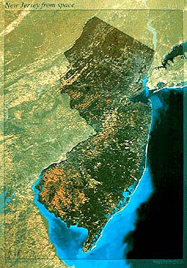
NEW JERSEY
INVASIVE SPECIES
STRIKE TEAM
Our Mission: Prevent the spread of emerging invasive species across New Jersey
New Jersey’s first Cooperative Invasive Species Management Area (CISMA)
Formed in 2008 as Central Jersey Invasive Species Strike Team
Expanded statewide in 2011 & incorporated as 501(c)(3) organization
www.njisst.org
Notes:
2

Slide 3
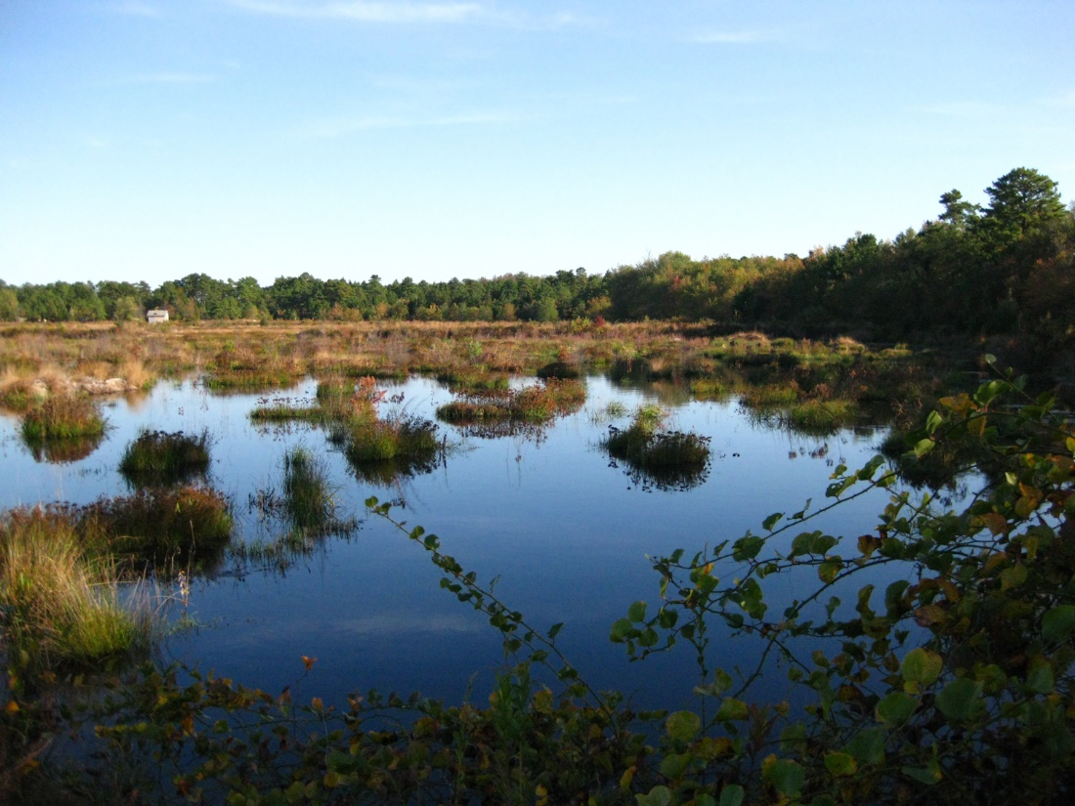
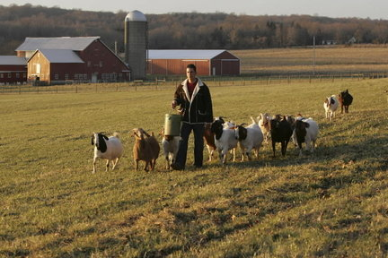
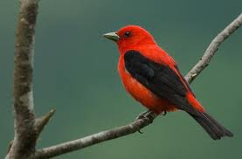
What are we protecting?
Notes:
3

Slide 4
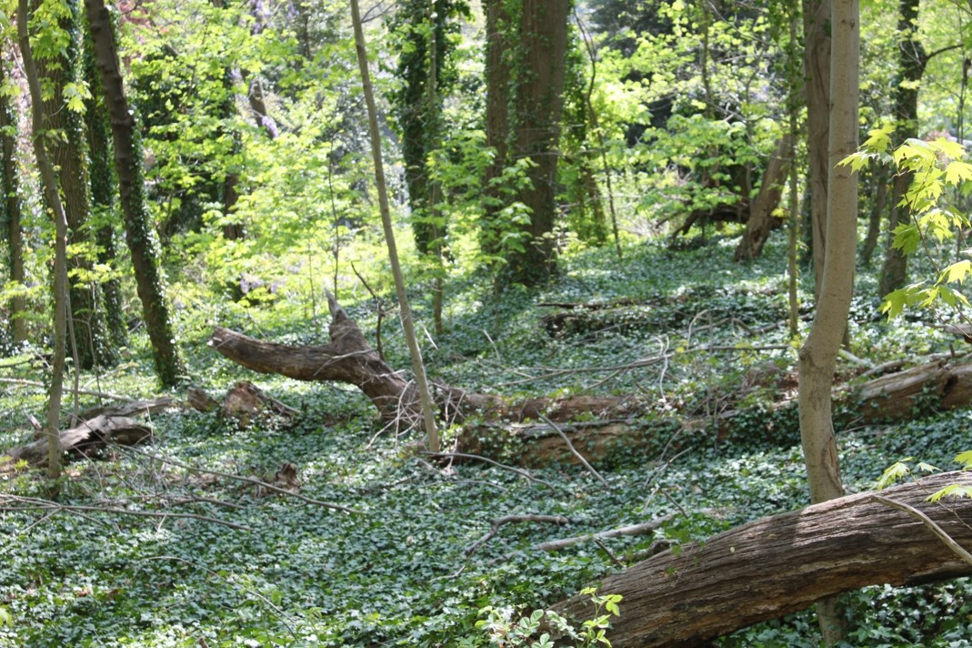
Invasive Species
Non-native
Negatively impact other species
Reduce biodiversity
Interrupt the natural functions of an ecosystem
Invasive Species
can be:
Plants
Birds
Insects
Pathogens
Amphibians
Crustaceans
Mammals
Mollusk
Reptile
Fish

Slide 5
Impacts of Invasive Species
Prey on native species
Example… Northern snakehead
Wreak havoc when they become entangled in machinery
Example… Kudzu
Inhibit the growth of crops & native forest species
Example… Garlic mustard
Change soil chemistry & reduce its stability & productivity
Example… Autumn olive
Form dense mats on ponds & clog slow‐moving irrigation
channels
Example… Water chestnut
Destroy plants from the roots up
Example… Phytophthora root rot
Notes:
Second greatest threat to biodiversity worldwide – only the destruction of habitats poses a greater risk

Slide 6
INVASIVE SPECIES

Slide 7
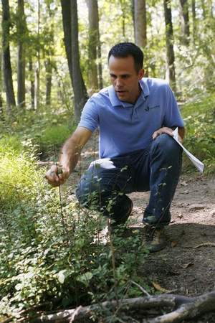
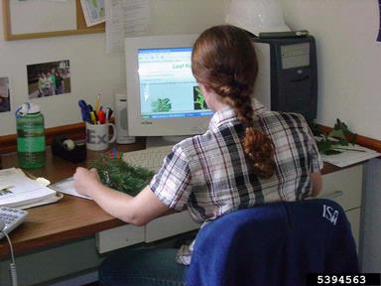
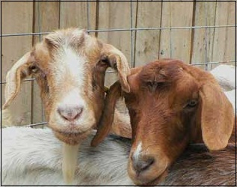
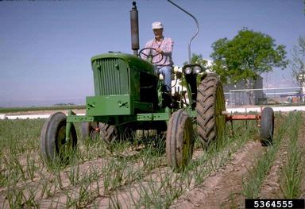
Collaboration is Key
New Jersey Invasive Species Strike Team
Over 200 Partners Representing
all levels of government
non-profit conservation groups
consulting foresters and related businesses
private individuals
Staff
Susan Brookman, Executive Director
Contractors
Mike Van Clef, Science Director
Jim Hansen, GIS Director
Rachel Mackow, Technical Specialist
Beth Craighead, Technical Specialist
Board of Directors
Jon Wagar, Director of Operations for Duke Farms
Ken Klipstein, Director of Watershed Protection, New Jersey Water Supply Authority
Alda Krinsman, Attorney (Retired)
Keri Benscoter, Resource Management Specialist, Highlands Water Protection and Planning Council
Randy Santoro, Principal Member of Technical Staff, AT&T
Technical Advisory Committee
Thom Almendinger, Duke Farms
Bruce Barbour, Rutgers Cooperative Extension
Kerry Barringer, Board Member – Flora of North America Association
Jeanette Bowers-Altman, NJ Division of Fish & Wildlife
Chris Doyle, Allied Biological
Art Gover, The Pennsylvania State University
Larry Herrighty, NJ Division of Fish & Wildlife
Mark Mayer, NJ Department of Agriculture
Christopher Smith, NJ Division of Fish & Wildlife
Robert Somes, NJ Division of Fish & Wildlife
Notes:
Our shared-services model, which incorporates Strike Team staff, partners, private landowners and volunteers, provides leverage to achieve far more than any one group could accomplish on its own.

Slide 8
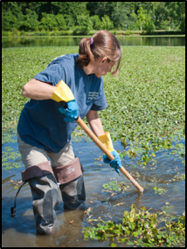
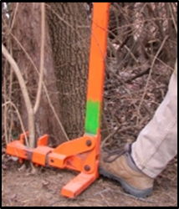
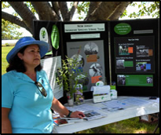
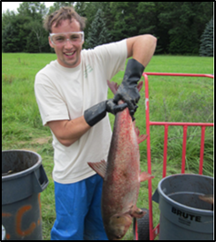
Our Methods
Outreach
Volunteer Ambassadors attend community events
Programs for property managers, elected officials, garden clubs & civic associations
Invasive plant buy‐backs
Training
Classroom & Field Sessions teach participants to:
Identify targeted species
Properly record data about populations they detect
Safely initiate control/eradication efforts
Mapping, Data Analysis & Reporting
Data is mapped, analyzed & shared through our web site
Continually assess distribution & densities of target species
Identify sources & trends of emerging infestations
Provide alerts about species found in the mid‐Atlantic & New England
Searching (Early Detection) & Eradication (Rapid Response)
Public & private land stewards search for emerging invasives
Eradication efforts take into consideration the best management practices in place for each target species
When eradication is not fully possible, we work to contain the populations of each target species
Notes:
Our Methods
Mapping, Data Analysis & Reporting: All data we gather is uploaded into our comprehensive database where it is mapped, analyzed & shared through our web site. We continually assess distribution & densities of target species, identify sources & trends of emerging infestations in order to preempt their spread, & provide alerts about species found in the mid‐Atlantic & New England in order to prevent their proliferation into New Jersey.
Outreach: Activities occur on many fronts & we tailor our message to each audience. Volunteer Ambassadors represent the Strike Team with a table‐top display at community events, we host invasive plant buy‐backs where citizens trade an invasive plant they dug from their garden for a coupon from a local nursery to replace it with a non‐invasive plant (we encourage voluntary restrictions on the use of invasive plants & hope that by addressing both the supply & demand for them, we will make significant progress in reducing their presence in cultivated landscapes), & we present programs to groups such as property managers, elected officials, garden clubs & civic associations. Our work with property managers & elected officials is designed to encourage & facilitate invasive species management. Public programs focus more on personal responsibility ‐‐ for example, we promote the use of native plants, encourage boaters & anglers to clean their equipment to stop the spread of aquatic hitchhikers & help trail enthusiasts understand how their boots can transport invasive plant seeds.
Training: We conduct both classroom & field sessions to teach participants to identify targeted species, properly record data about populations they detect & safely initiate control/eradication efforts.
Searching (Early Detection) & Eradication (Rapid Response): Our fundamental approach to the control of emerging invasive species involves harnessing the stewardship potential of public & private land stewards. Once a site has been searched, eradication activities are planned, taking into consideration the best management practices in place for each invasive species being targeted. When eradication is not fully possible, we work to contain the populations of each target species so that they will not spread.
In sum: Understanding WHAT is WHERE, WHEN it’s a problem and HOW to get rid of it.

Slide 9
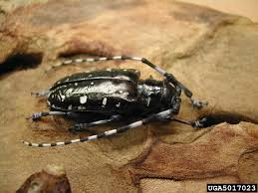
How do species get in the “wrong” place?
Unintentional Introduction
Cultivation & Landscaping
garlic mustard, buckthorn
Nursery Stock
wooley adelgid, chestnut blight
Ship Ballast
zebra mussel, round goby
Boats, Planes, Trucks & Trains
brown tree snake, Eurasian water milfoil
Packing & Shipping Materials
Japanese stiltgrass, Asian long-horned beetle

Slide 10
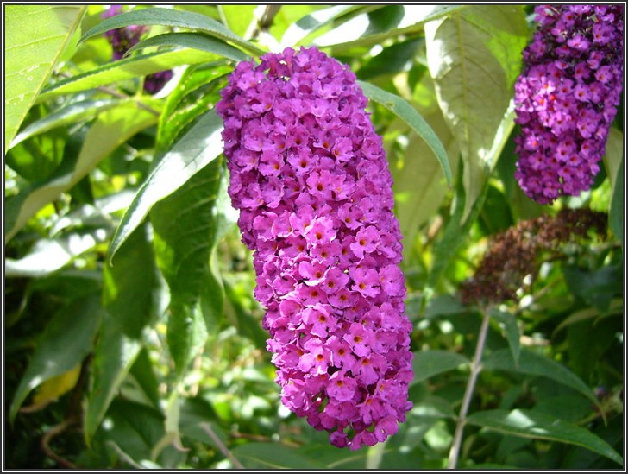
How do species get in the “wrong” place?
Deliberate Introduction
Sport Fishing
snakehead, rainbow trout
Pet Trade
hydrilla, pythons
Biocontrol
Grass carp
Erosion Control
kudzu
Gardening & Landscaping
purple loosestrife, butterfly bush

Slide 11
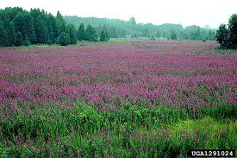
How do species get in the “wrong” place? The Climate Change Connection
Since the beginning of the 20th century, the growing season in many areas of the lower 48 states has expanded by about two weeks…
Many nonnative species are changing their flowering schedule in concert with the longer growing season. At Walden Pond, purple loosestrife blooms 24 days earlier than it did a century ago.
Notes:
Botanists have learned that several invasive species are, by nature, highly flexible, and respond to unusual environments more quickly than do natives. And now, with the help of climate change, the invasives also reap the benefits that come with early blooming—such as shading out competitors and capturing a larger share of nutrients, water or pollinators.

Slide 12
How climate change facilitates the spread of invasive species
Increasing frequency of extreme weather events
Ability to alter critical components of natural systems such as
temperature
precipitation
atmospheric composition
land cover
When heavy winds topple trees in forests, invasive plants often outcompete natives for the sunlight streaming in through newly-opened gaps in the canopy.
When rivers overflow their banks, invasive plants and animals can be transported to new sites.
Higher average temps lengthen growing seasons, enhance winter survival rates of species that would otherwise suffer die-backs due to freezes, & expand aquatic habitats for invasive warm–water species & stress populations of native cool-water species.
Notes:
There is considerable evidence suggesting that future climate change will further increase the likelihood of invasion as well as the consequences of those invasions. This is largely because of the potential for complex interactions between 1. the impact of warming and precipitation changes on population dynamics and species distributions, 2. increased ecosystem disturbance (e.g. wildfire, hurricanes), 3. the enhanced competitiveness of some invasive plants due to elevated CO₂, and 4. increased stress to native species and ecosystems

Slide 13
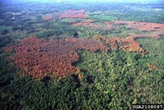
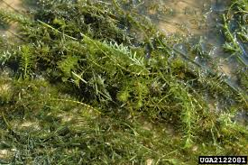
CLIMATE CHANGE & INVASIVE SPECIES
WARMER TEMPERATURES
Hydrilla verticillata may increase growth rates and biomass in elevated temperatures (Chen, 1994)
Southern invasive species marching northward
Example: Aerial view of a Southern Pine Beetle infestation. It is expanding northward with milder winters, killing trees & increasing fire risk
Expanded ranges - previously unable to overwinter (the tens rule)
Growing season extended - plants may move without natural predators
Tropical pets - increased survival
Pathogens - increased reproduction
Notes:
The tens rule is a generalization of how many exotic species are likely to become invasive
Of all exotics brought into an area about 10% will establish in wild
Of all those established in wild about 10% will establish self- reproducing pops
Of all self-reproducing pops, 10% will become invasive
Thus about 1/1000 species introduced will become invasive, as a general rule of thumb

Slide 14
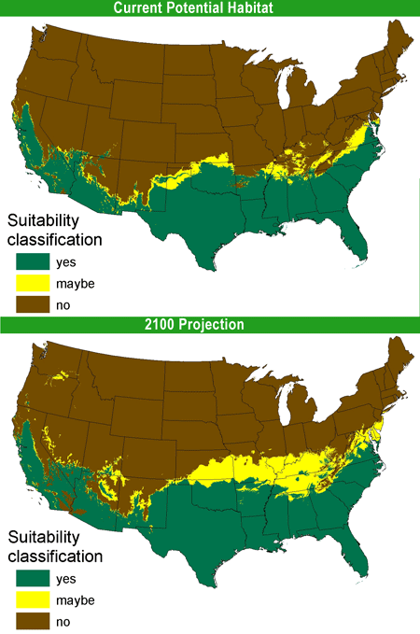
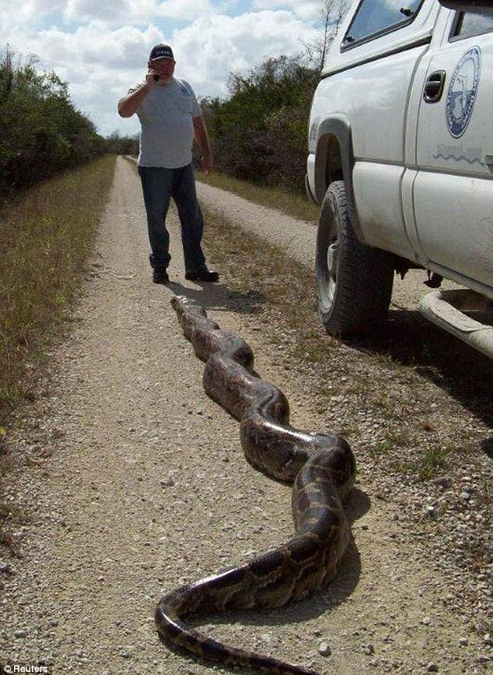
Species on the Move
USGS projection
of Burmese python spread

Slide 15
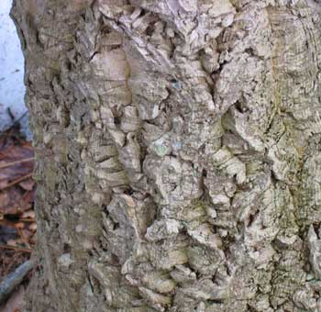
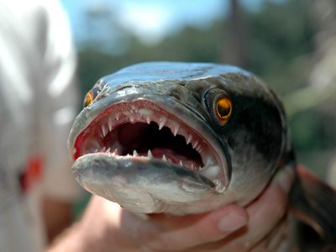
Species on the Move
Northern Snakehead
Stage 0 → Stage 3
Amur Corktree
Stage 0 → Stage 1

Slide 16
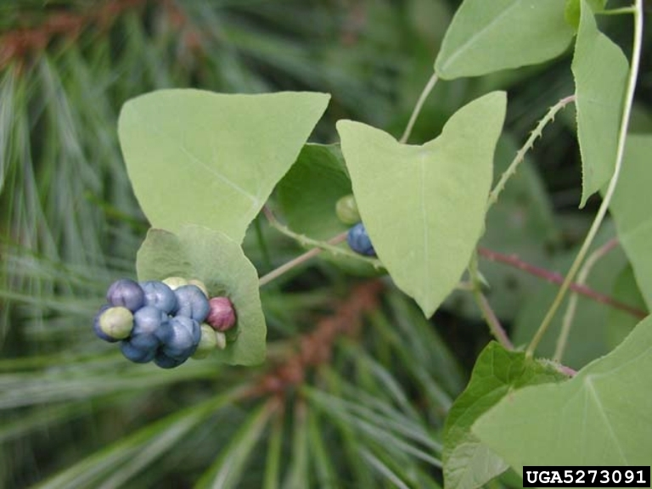
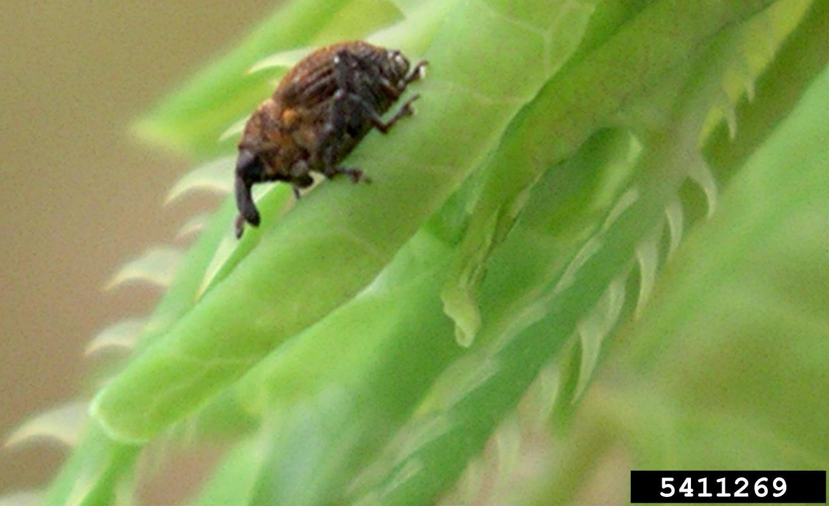
Species on the Move
Mile-a-Minute
Stage 3 → Widespread

Slide 17
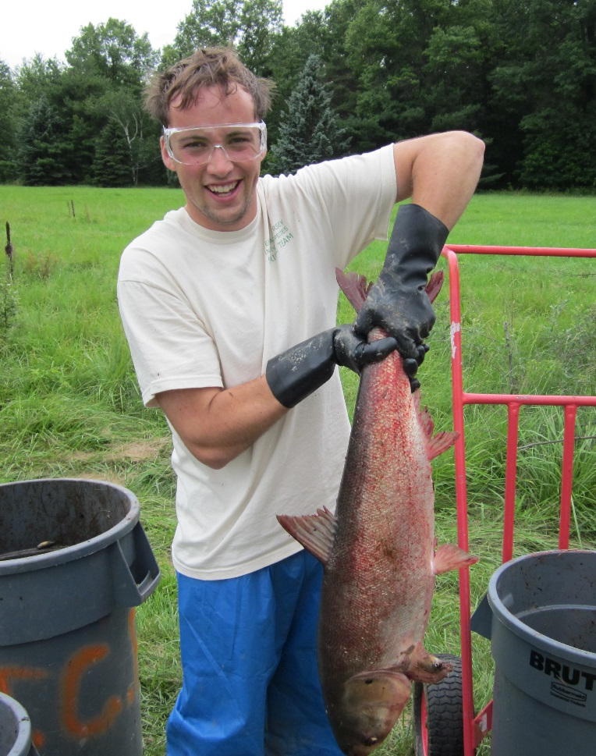
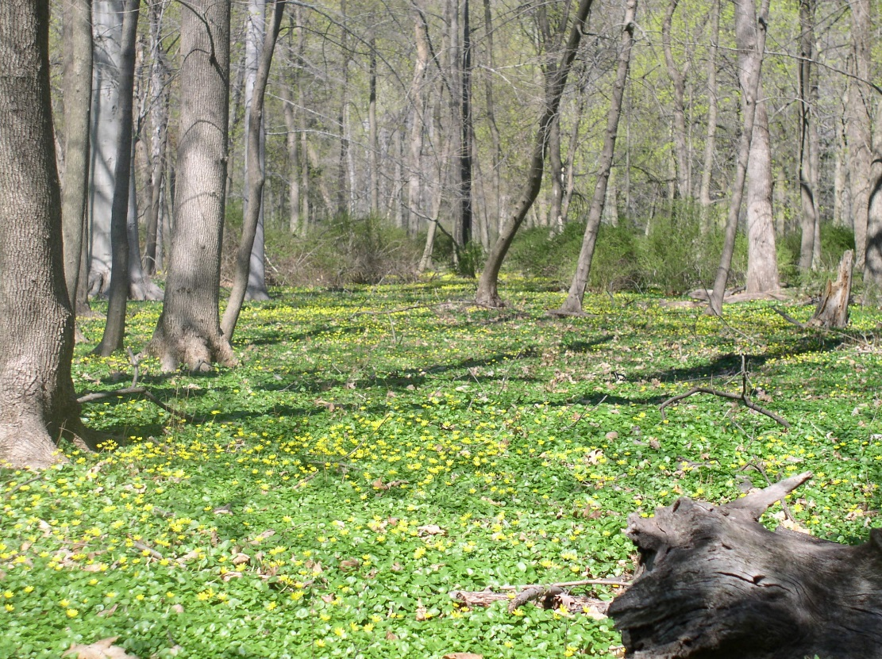
CLIMATE CHANGE & INVASIVE SPECIES
INCREASED STORM EVENTS
Flooding & erosion
Greater dispersal of upstream invasive species to downstream habitats
Example: lesser celandine can regrow from plant fragments
Facilitate the escape of harmful species from aquaculture
Example: escape of Asian carp into the Mississippi River
Notes:
Disturbances do not necessarily lead to successful species invasions, but they can provide an environment conducive to plant invasion. Therefore, post-disturbance invasion may be particularly problematic in areas adjacent to invasive plant seed sources (wildland urban interface areas), and influenced by key pathways (roads), and vectors (e.g. wild animals and recreationists dispersing seeds) as propagule pressure is a key factor in the invasion process.

Slide 18
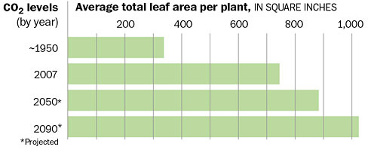
CLIMATE CHANGE & INVASIVE SPECIES
INCREASED CARBON DIOXIDE
Increased photosynthesis as a result of recent and projected increases in CO₂ is one of the most researched aspects of global change
Increased CO2 seems to favor growth of invasive species, in particular vines
Bigger plants = more seeds + better seed dispersal
Stronger roots = stronger herbicides
Major factor vine growth: freezing temperatures
Poison Ivy
Increase CO2 =
more leaf & stem production + more urushiol
Notes:
Scientists have known for over 200 years that enhanced levels of CO₂ stimulate plant growth. Increased photosynthesis as a result of recent and projected increases in CO₂ is one of the most researched aspects of global change (16,4). There is some evidence that elevated CO₂ may favor weedy plants (17).

Slide 19
Invasive species
Climate change
??
Notes:
In general, IS tend to exhibit characteristics that give them a competitive advantage over native species for food and habitat, and increase their reproductive potential. These characteristics include things like rapid reproduction, high adaptability, voracious appetites, and lack of predator pressure. Adding climate change effects could exacerbate the problem by enhancing these characteristics and further increasing the suitability of habitats for IS.
In a hypothesized response to climate change, several studies have documented the movement of species poleward and/or upward in elevation, (e.g., 18,19) although this trend has not been found universally (20).
Invasives might move faster than native species, since they tend to have higher dispersal ability and genetic flexibility, among other features.
Some invasive species may also presently occupy only a portion of their potentially available habitats, thus having the potential to spread widely (21).
Species interactions and species' lag times responding to environmental changes are also important to consider. Species performance such as growth, phenology, and productivity may also change in novel conditions (22).
However, it is unclear how important direct environmental effects such as changes in CO2, temperature and precipitation will be, compared to other invasion drivers such as disturbance, propagule pressure, and biotic resistance.

Slide 20
Determining Our Risk in 5 Easy(!) Steps
determine potentially invasive species
2. estimate New Jersey’s future climate
3. assess climate suitability for potentially invasive species
4. estimate levels of invasiveness for those species that prove to have high levels of climate suitability
5. consider other factors associated with invasive species movement
Notes:
We’ve identified 40 species to place on our watch list for 2015
4 birds 5 fish 1 insect 5 invertebrates 1 mammal 24 plants
house finch
brown-headed cowbird
house sparrow
European starling
grass carp
brook stickleback
warmouth
green sunfish
oriental weatherfish
Asian tiger mosquito
earthworm (Lumbricidae)
earthworm (Lumbricidae)
earthworm (Lumbricidae)
earthworm (Lumbricidae)
earthworm (Lumbricidae)
feral cats
Japanese chaff flower
water wheel plant
purple stemmed dodder
variable flatsedge
Japanese net-veined holly fern
Scotch broom
duetzia
thorny elaeagnus
Sickleweed
hairy crabweed
seaberry
blue plantain lily
chameleon-plant
Himalayan balsam
golden raintree
yellow archangel
snowbell
Beale's barberry
Java dropwort
holly osmanthus
hardy orange
Chinese buckthorn
hardy pampas grass
Chinese willow
Jupiter's distaff

Slide 21
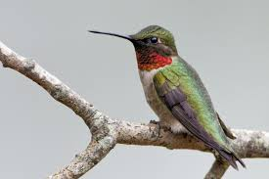
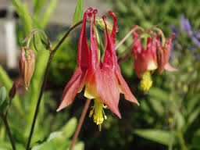
CLIMATE CHANGE & INVASIVE SPECIES
IMPACTS ON NATIVE SPECIES
Changes in range
Changes in timing of natural events
Widespread forest loss (drought & warming create vulnerable trees)
Diminished habitat for native animals from dryer or wetter areas

Slide 22
Climate change is underway… and to some extent, no matter what actions we take as a global community, its continued progress is guaranteed
Climate change is opening doors to invasive species, but we do not have to have to stand idly by…
We can arm ourselves with knowledge about the invasive species most likely to cross New Jersey’s thresholds, be on the lookout for them & strike as soon as they are detected!
Notes:
Determining how suitable NJ’s climate will become for new non-native species, and determining in advance which species might be at risk of expanding their ranges into our state, can help shift resource managers from working on reactive management strategies, to more proactive thinking about prevention, rapid response, and control.

Slide 23
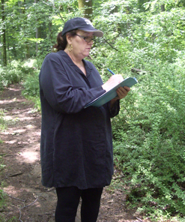
APPlying New Strategies to Nip Invasive Species in the Bud
Using Smartphones & Tablets
in the field to identify & manage invasive species
In the past, survey & detection work required people to carry clipboards, pencils, data sheets, cameras, gps units & field guides.
Reporting data required the transfer of field data to spreadsheets.
Clearly there was a need to offer people better ways to identify the invasives that threaten our state, pinpoint where those invasives are located & report data to the Strike Team.
Enter NRCS
& the
Smartphone!

Slide 24
IPC Connect New Jersey web app
Track eradications
Track pesticide use
Access best management practices
Track hours of work
Update status of previous work
Notes:
After a record is entered and verified from the smartphone app it is available in IPCConnect New Jersey web app

Slide 25
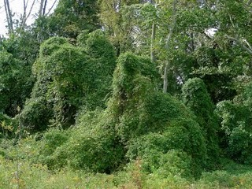
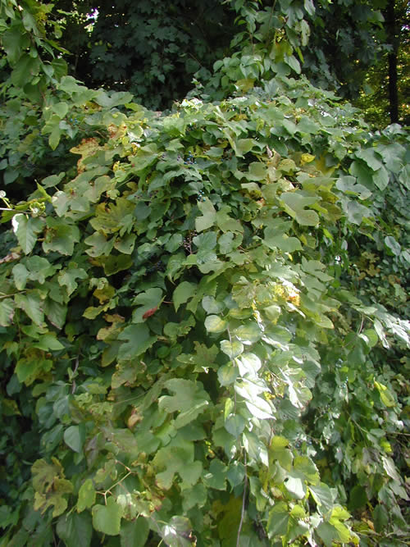
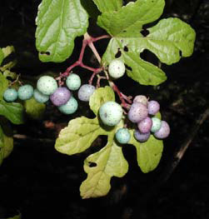
Porcelainberry (Ampelopsis brevipedunculata)
Emerging Stage 3 - Stream banks, floodplains, roads,
fields, edges
Notes:
Perennial, climbing, woody-stemmed vine
• Grows 10’ - 20’ or more
• Climbs by tendrils, similar to native grapes
• Pith (center) of mature stems is white
• Bark does not peel and has lenticils
Leaves
• Alternate
• 3 - 5 lobes on each leaf, heart-shaped base
• Extremely variable leaf shape/lobing
• Coarse teeth
• 2” - 4” wide
• Young twigs, leaf stems and the undersides of the leaves are hairy
Flowers
• Small, greenish-white
• Blooms in clusters, May - August
Fruit
• Speckled, 0.25” spheres
• Ripening from September - October
• Fruits are borne in clusters
• Vary in color from yellow to lilac to green, and mature to a blue color

Slide 26
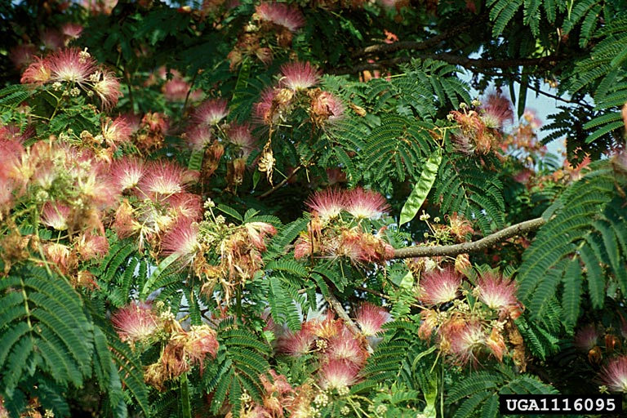
Mimosa (Albizia julibrissin)
Emerging Stage 2 - Dry plains, sandy valleys and uplands
Notes:
26
• Small deciduous tree • Broad crown of level branches.
Leaves
• The leaves are bipinnate (ie double compound) • 20 – 45 cm long and 12 – 25 cm broad, divided into 6 – 12 pairs of pinnae • 20 – 30 pairs of leaflets on each double compound leaf • Leaflets are oblong, 1 – 1.5 cm long and 2 – 4 mm wide
Flowers
• Produced throughout the summer, dense pink and white. • Tight cluster of stamens 2 – 3 cm long, white or pink with a white base, looking like silky threads • Fern-like or feathery appearance, very ornamental
Fruit
• Flat brown pod 10 – 20 cm long and 2 – 2.5 cm wide, containing several seeds inside. • Characteristic legume appearance

Slide 27
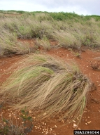
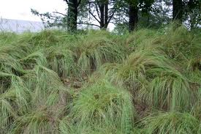
Weeping Love Grass (Eragrostis curvula)
Emerging Stage 2 - Roadsides, meadows, Pine Barrens
Notes:
• Warm-season, perennial grass, 1’-4’ tall • Clumping habit • Not rhizomatous • Does not spread from nodes
Leaves
• Typically reclining rather than upright • Arched, flat, narrow, 0.1” wide • Grey-green • Ligule (tongue-like organ located at leaf/stem junction) with long hairs • Fringed sheath (leaf base surrounding stem)
Flowers
• Diffuse, not showy • Nodding, small. 0.2”-0.4” long, 0.1“ wide and gray-green • Blooms late summer-early fall
Fruit
• Small, yellow seeds

Slide 28
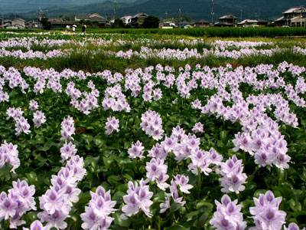
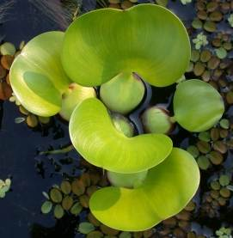
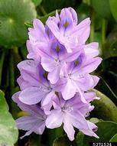
Water hyacinth (Eichhornia crassipes)
Emerging Stage 0 – Nearest site is Washington DC
Lakes, ponds, slow moving waterways, ditches, and backwater areas
Notes:
28
Free floating aquatic perennial • Grows up to 3’ tall • Roots blue-black to dark purple • Can reproduce by seeds or runners
Leaves
• Thick, waxy, round leaves • 6” wide • Thick, spongy, bulbous petiole that grows up to 12” long
Flowers
• Showy 12” long spike • Flowers are each 2” wide, pale purple with one yellow spot • Each flower has 6 petals
Fruit
• 3-celled capsule with many seeds • Fruit and seeds rarely seen
28

Slide 29
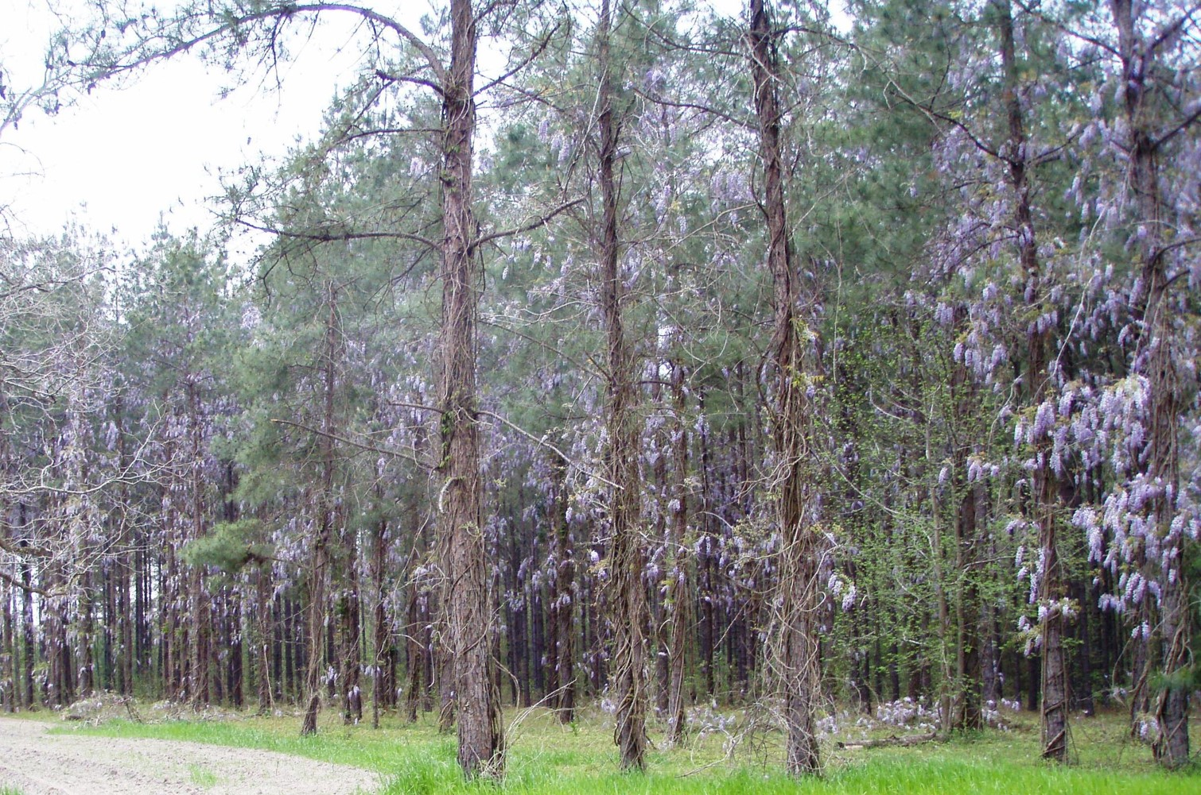
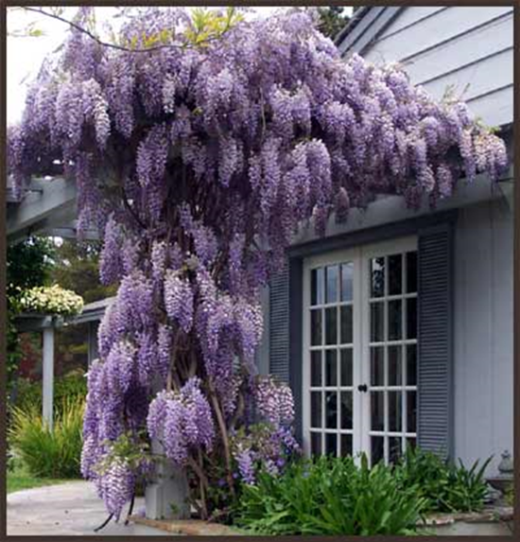
Japanese & Chinese wisteria (Wisteria floribunda & sinensis)
Emerging Stage 2 and 3 -
Roadsides, forest edge, open woods, stream edges, meadows
Notes:
General Description
• Deciduous woody vine • Smooth light gray bark • Can reach heights of 40’ and grow 10’ wide • Mature stem is fluted, muscle-like • Twines up counter-clockwise • Sends out a large amount of “runners,” vines that travel along the ground making a very dense root network
Leaves
• Alternate leaves, pinnately compound with a terminal leaf • Leaves are 4-16” • There are 13-19 leaflets, each 3” long
Flowers
• Blooms mid-May, but only when it is mature and in full sunlight • Lavender, purple, or white hanging clusters • All flowers open simultaneously • 6-20” long
Fruit
• Bean-like pods, 4-6” long • Green and hairy, turns brown and cracks when mature
Habitat
• Prefers moist soil, shade tolerant • Roadsides, forest edge, open woods, stream edges, meadows, gardens, and landscaping
Commercially Available
Yes
Look-alikes
America Wisteria (Wisteria frutescens)
• Native vine of Southeast, introduced further north • Leaves 4”-12” long • 9-15 leaflets, each 0.75”-2.5” long • Not fragrant, inflorescences 4”-10” long • Blooms June-August • Hairless seed pod
Trumpet Vine (Campsis radicans)
• Native vine of Southeast, introduced further north • Opposite and pinnately compound leaves, serrated • Blooms in late spring through early summer with orange-red elongated flowers
Control Recommendations
Foliar Spray: FS-1
• Glyphosate 3.75%, Triclopyr Amine 2.50% • Please see our Herbicide Use Suggestions and Mixing Guide for more information
Basal Bark: BB-1
• Triclopyr Ester 25% OR Pathfinder II ready-to-use mixture • Please see our Herbicide Use Suggestions and Mixing Guide for more information • Pre-treatment cutting is recommended when tall/dense/multi-stem tangles prohibit safe application via foliar spray • Species has thick/waxy leaves -- utlilize Clean Cut surfactant or equivalent

Slide 30
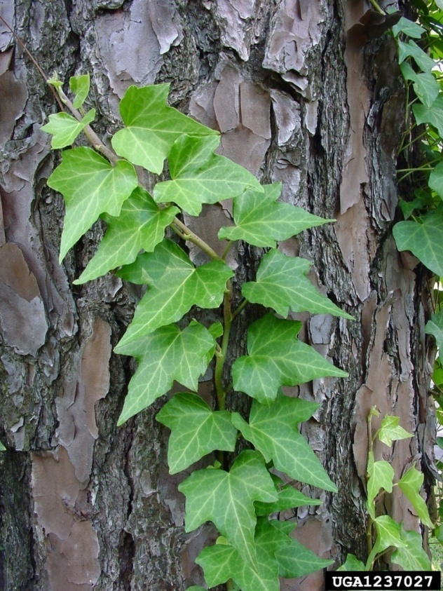
English ivy (Hedera helix)
Photo by Melissa Almendinger, Mt. Holy, NJ
Emerging Stage 3 - Forest, edge, field, coastal areas
English ivy serves as a reservoir for Bacterial Leaf Scorch (Xylella fastidiosa), a pathogen harmful to elms, oaks, maples and other native plants
Notes:
30
• Perennial, climbing, evergreen vine or groundcover • Climbs using small, sticky root-like structures • Can smother shrubs and trees • Older vines can grow to 1” in diameter NOTE: English ivy serves as a reservoir for Bacterial Leaf Scorch (Xylella fastidiosa), a pathogen that is harmful to elms, oaks, maples and other native plants.
Leaves
• Alternate, dark green with white veins • Waxy or leathery • No toothing on edges • Usually 3 - 5 lobes per leaf - leaves may appear triangular • Mature, flowering plants may have unlobed rounded or heart shaped leaves • Many cultivars are available making leaf color variable- may be edged in white, reddish, or yellowish
Flowers
• Small, pale yellow-green • Borne on terminal clusters • Blooms August - September • Flowering triggered by sunlight (often requires climbing to flower) • Vines may grow for up to 10 years before flowering
Fruit
• Black to purple fruits • Thin fleshy outer covering • 1 - 3 hard seeds • Ripening October - November

Slide 31
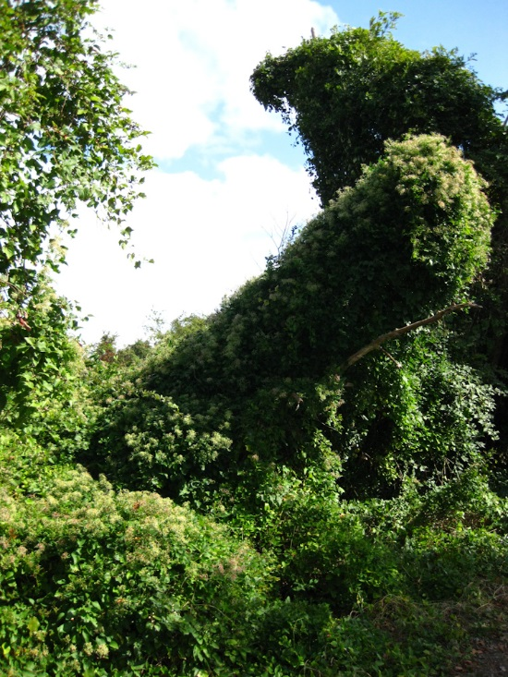
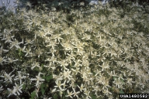
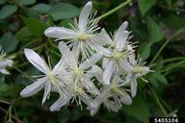
Japanese Clematis (Clematis terniflora)
Emerging Stage 3 - Forest edges, floodplains, streams and shorelines
Notes:
• Climbing woody vine • Can be evergreen • Can grow 20 - 40’ in one year, very aggressive
Leaves
• Opposite • Compound with 5 (occasionally 3) oval or heart shaped leaves • Usually untoothed
Flowers
• Small, white, 4 petals • Fragrant • Abundant, forms a very noticeable blanket of flowers • Blooms August to September
Fruit
• Showy cluster of seeds • Long feathery plumes, persistent
31

Slide 32
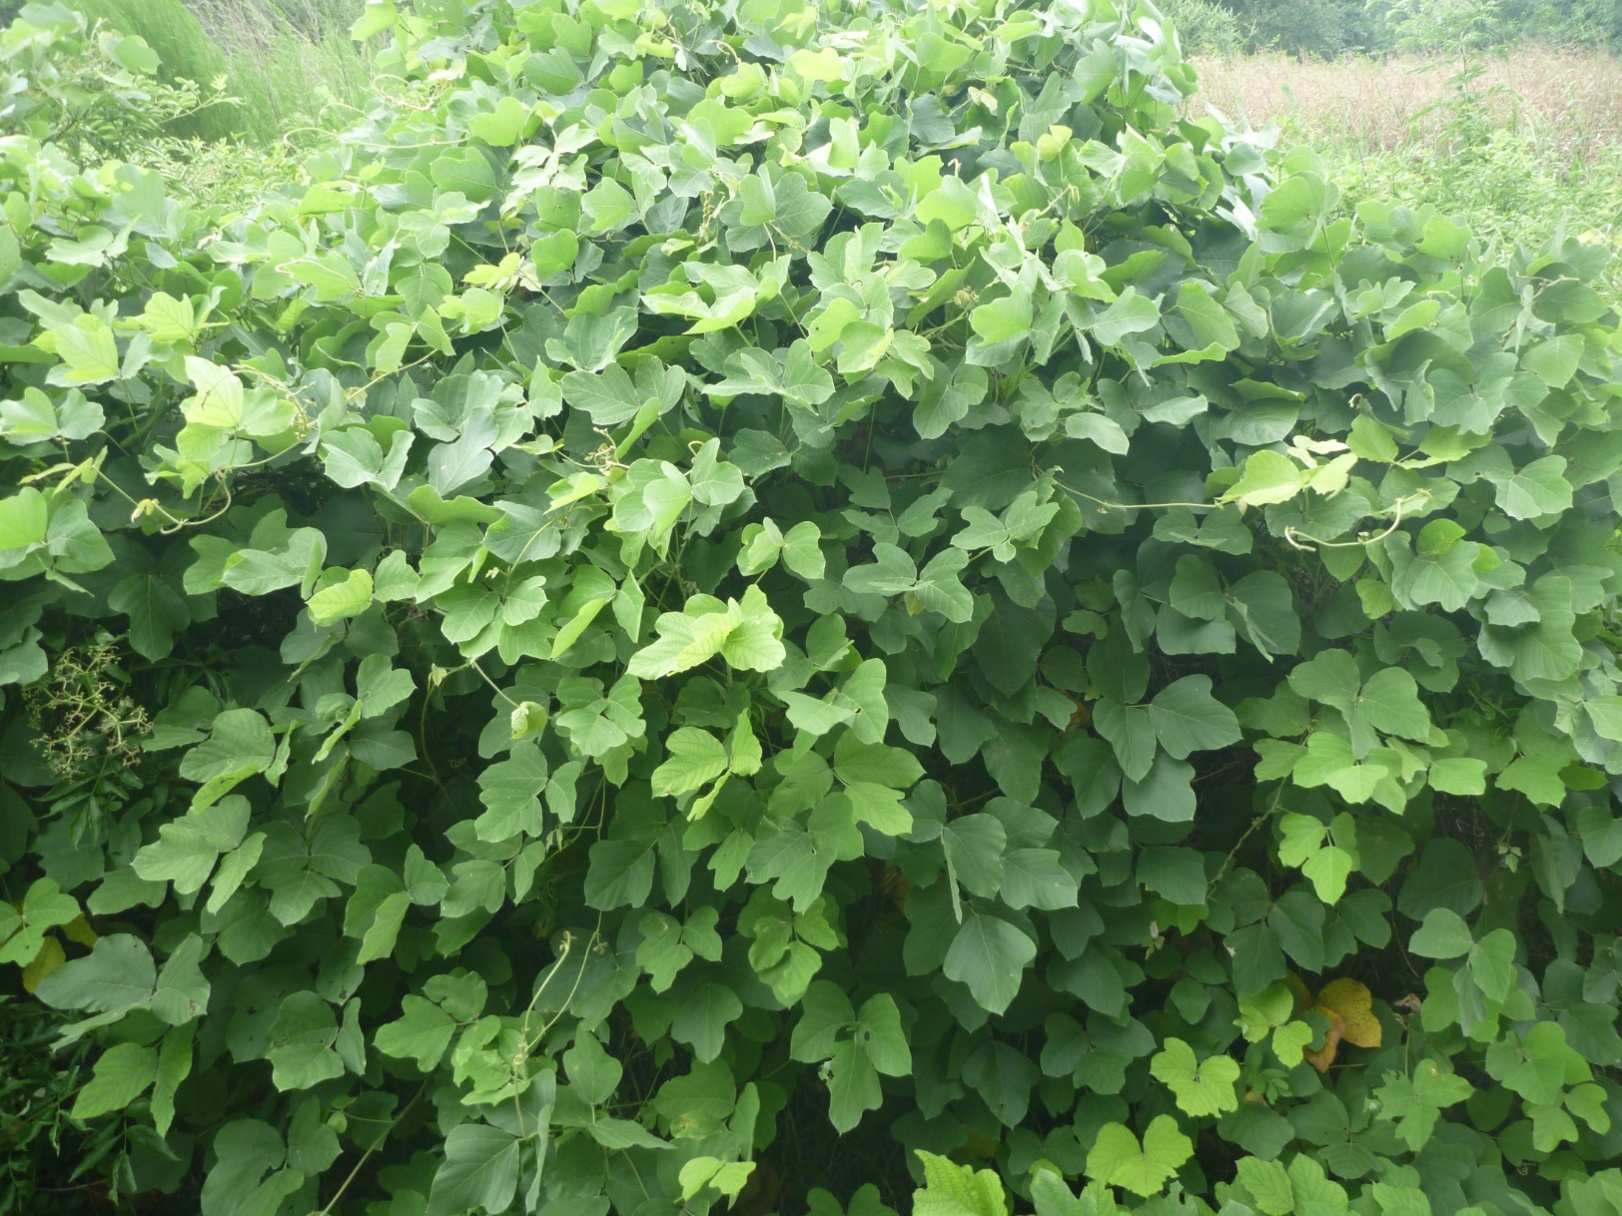
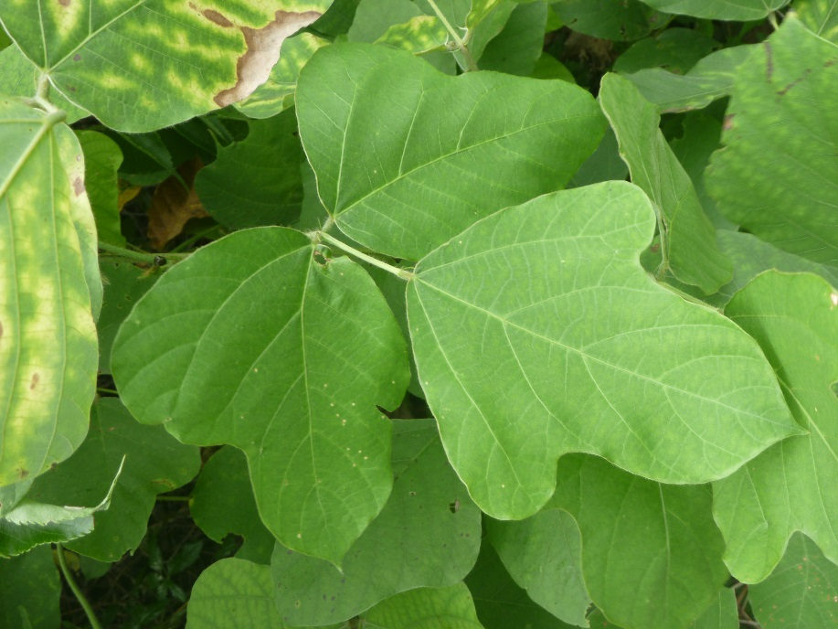
Kudzu (Pueraria montana)
Emerging Stage 1 - Forest edge, meadow, abandoned fields, roadside, dams
Notes:
Climbing or trailing semi-woody perennial vine • Up to 100’ long • Stems up to 2” thick • Fleshy tap root up to 7” wide and 9’ deep, weighing 400 lbs.
Leaves
• Alternate, compound • 3 oval leaflets up to 4” wide • Untoothed • Leaflet shape variable — can be tear drop shaped or lobed • Leaf edges hairy
Flowers
• Fragrant, pea-like, purple • Borne in long clusters • Blooms August-early September
Fruit
• Brown, hairy, flattened seed pods about 8” long • Each pod contains 3 - 10 hard seeds. • Ripening in September to October

Slide 33
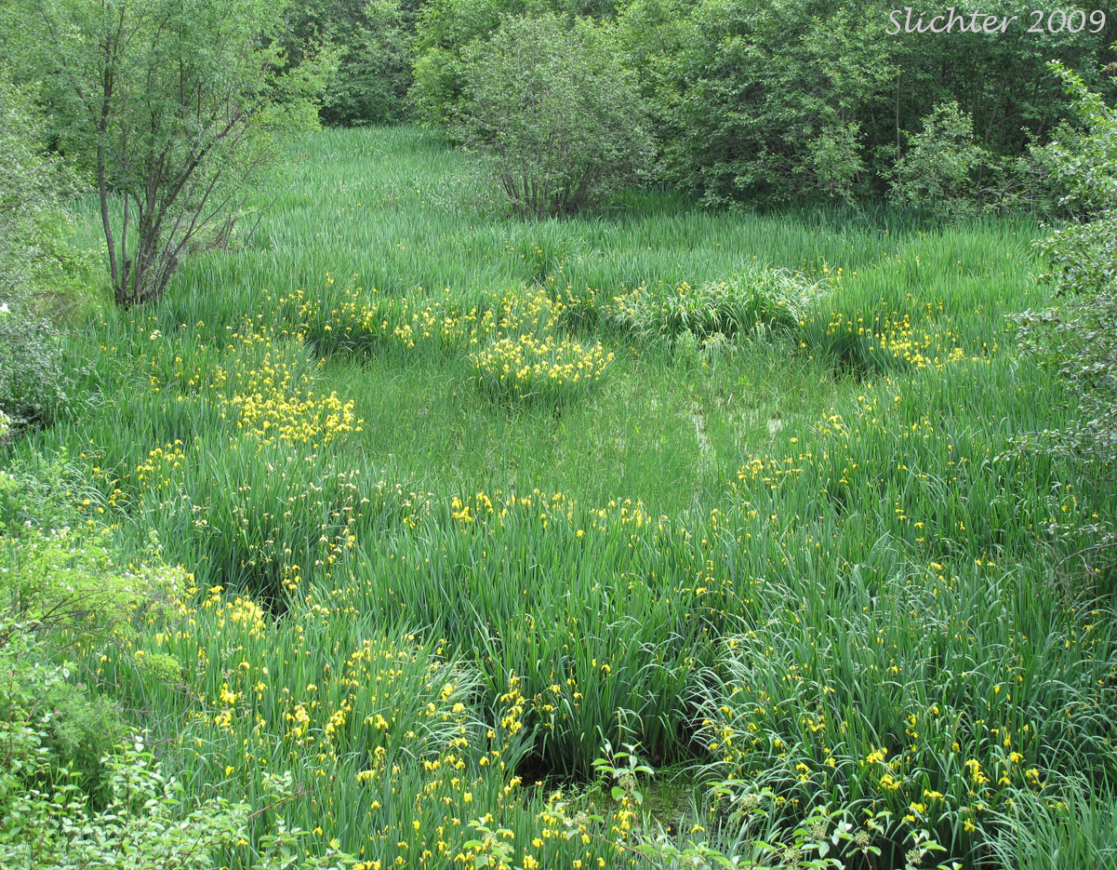
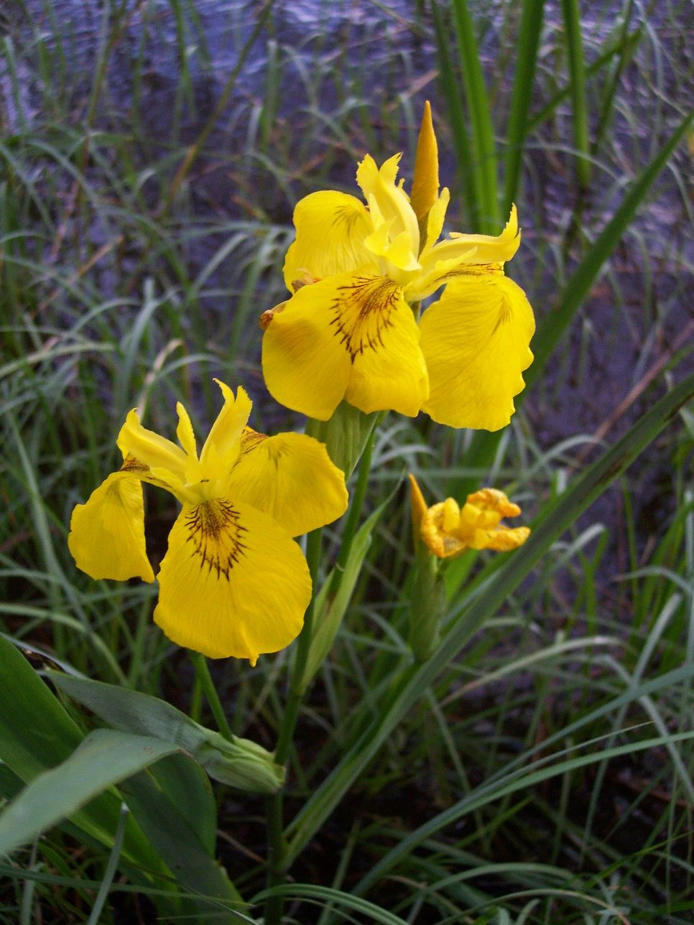
Yellow iris (Iris pseudoacorus)
Emerging Stage 3 - Floodplain forest, marsh, wet meadow, shorelines
Notes:
Herbaceous clump-forming perennial • 3’-4’ tall • Strong roots, that are pink in color
Leaves
• Broad, sword-shaped, emanating from a central base • About 1.6’-3.3’ long • Stiff, upright • Glaucous (waxy coating)
Flowers
• Showy, bright yellow, (occasionally whitish to cream-colored) • Multiple flowers grow on each stem • Individual flowers 2.75”-3.5” wide • Blooms late April-June
Fruit
• 6-angled seed capsule containing up to 120 seeds • Mature capsule opens into 3 widely spreading segments • Seeds mature from white to brown • Ripens in July-August
33

Slide 34
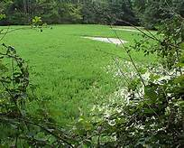
Parrot feather (Myriophyllum aquaticum)
Emerging Stage 0 - Lakes, ponds and slow moving streams
Notes:
Herbaceous rooted submergent (completely below water) or emergent (piercing through water) plant • Stems trail along ground or water surface; become erect & leafy at ends • Stems 5’-6’ long
Leaves
• Each leaf is pinnately compound (1 center stem with many leaflets) • Abundant, bright green, feathery • 4-6 leaves whorled around stem • Emergent leaves are larger, less divided & greener than submerged leaves • Submerged leaves: 0.6”-1.5” long • Emerged leaves: 0.8”-2” long
Flowers
• Inconspicuous • Formed in the axils of emergent leaves • Blooms in spring (sometimes fall)
Fruit
• None, only female plants exist in North America. Reproduction occurs vegetatively.

Slide 35
Nutria (Myriophyllum aquaticum)
Emerging Stage 0 - Wetlands, semi-aquatic environments with emergent vegetation
Nearest site in Delaware
Notes:
Large, herbivorous, semi-aquatic rodent • Introduced to the US in 1930s and farmed for their fur • Adults weight 15 to 22 lbs (males larger than females) and 24” long (tail included). • Long, rounded, sparsely haired tail measuring 13 - 16” • Large yellow orange teeth • Life span of 8 to 10 years • Nocturnal, will feed during the day if food is scarce • Nutrias eat 25% of their body weight daily. • Eats roots, rhizomes, and tubers of plants. • Will create burrows, land nests, and platforms out of vegetation in shallow water
Life Cycle
• Sexually mature after 4 months • Females average 4 to 5 offspring per pregnancy, can have 2 litters per year • Male and 2 to 3 females share a den
What to look for
• Tracks show a small fore foot and a larger hind foot, 5”, with four webbed toes and a free outer toe. Tail drag marks are also seen between the footprints • Droppings dark green to black, 2” long and ½” wide, deep lines running along the droppings

Slide 36
CLIMATE CHANGE & INVASIVE SPECIES
WHAT SHOULD WE BE DOING?
Prevent the spread of new (emerging) invasive species
Learn which species are present in small numbers in your watershed
Learn which species are likely to invade your watershed
The Keys
Monitoring
Early Detection
Rapid Response
More Monitoring
The Tools
New Jersey Invasives
IPCConnect.com/NewJersey
Sweat Equity
Grow Natives

Slide 37
New Jersey Invasive Species Strike Team
P.O. Box 5752, Hillsborough, NJ 08844
908.722.1200, ext. 241
www.njisst.org
Together, We Can Nip New Invasive Species in the Bud
Notes:
37

