Slide 1
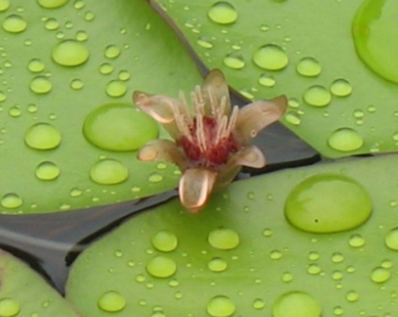
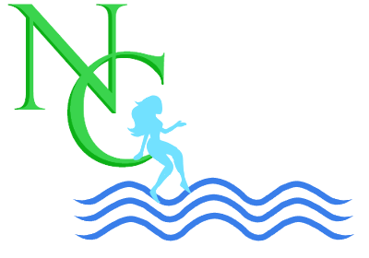
Adaptive Monitoring of Aquatic Plants
Chris Doyle, CLM

Slide 2
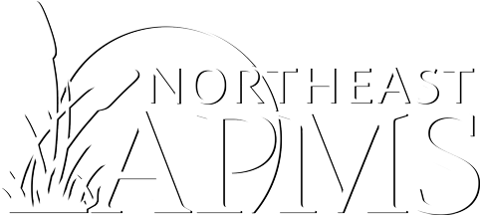
Aquatic Plant Camp
Sponsored by the Northeast Aquatic Plant Management Society
September 13-15, 2022
Taconic Outdoor Education Center, Cold Spring, NY
51 registered attendees from 6 states
Classroom Instruction and Field Trips
https://youtu.be/H0qpPaXPZYI

Slide 3
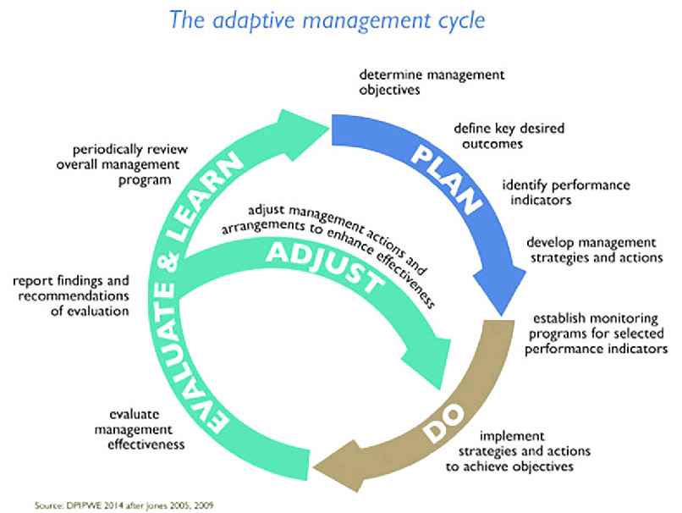
What is Adaptive Management?
A structured process of learning by doing, and adapting based on what's learned (Walters and Holling, 1990).
Often employed when managing natural resources
The Process can be applied to Monitoring Programs of a Management Plan.

Slide 4
When to Apply Adaptive Monitoring
Data Collection
Example: Hydrilla Tuber Monitoring
Environment
PIMS Surveys in canals and rivers
Littoral zone definition
Changing Conditions
Often the result of the Management Plan
Example: Shifting plant community to early season growing species
Budget Changes
Try to add to a program
If you need to take away, do it strategically

Slide 5
Strategic Removal of Collection Stations
Initial Monitoring Program: 25 Collection Stations
Revised Monitoring Program: 13 Collection Stations
Less effort = Less $
Still can compare ~50% of the data points

Slide 6
Project Planning
A Challenge when developing a 3 or 5 year Management Plan
RFPs are often “Low Bid”
Make Sure Adaptive Monitoring is part your Management Plan
Don’t Back Yourself into a Corner
“Living” Plan-review each year and revise as needed
Create a Budget Buffer
Specific to Monitoring Plan
Use the Budget Wisely
Don’t be afraid to make changes
But make sure they are scientifically based changes

Slide 7
Thank You!
Chris Doyle, CLM
Naiad Consultants
naiadconsultants@gmail.com
The Northeast Aquatic Plant Management Society (NEAPMS) is a diverse group of professionals dedicated to understanding the unique needs of aquatic plant management in the Northeast and communicating that knowledge to both the public and private sectors.
For more Information: https://www.neapms.org/

